Slide 1
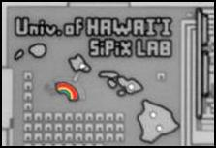

First detector and DAQ test results from the TEDA beamline
Matt Andrew, Mike Hadmack, Bryce Jacobson, Gary Varner
University of Hawaii
Experience from developing first integrated readout systems
and next development steps
27-APR-2011 ARI Grantees Conference

Slide 2
Giga-Hertz Detector and Data Acquisition
Simulated x-ray production, transport & detection:
  2 source configurations (bremsstrahlung, Compton backscatter)
  ~1ps timing, intense flux
x-ray beamline and first readout commissioned Sept 2010
Key development directions:
  Detectors
  High speed sampling ASICs
  High throughput readout
  Real time, fast feature extraction
Giga-Hertz, Giga-Samples/s and Giga-bits/s

Slide 3
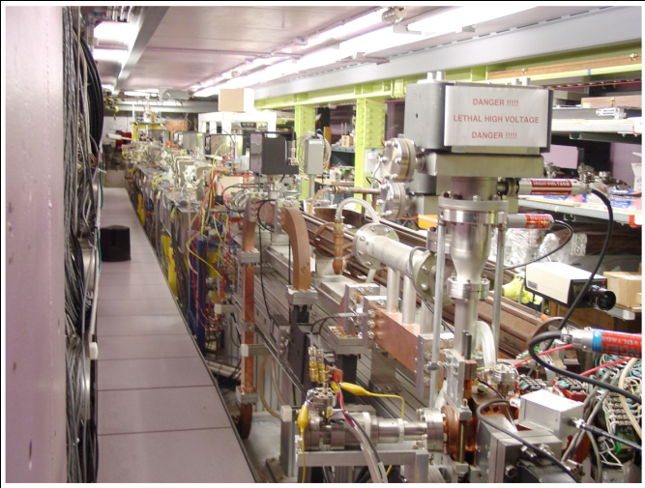
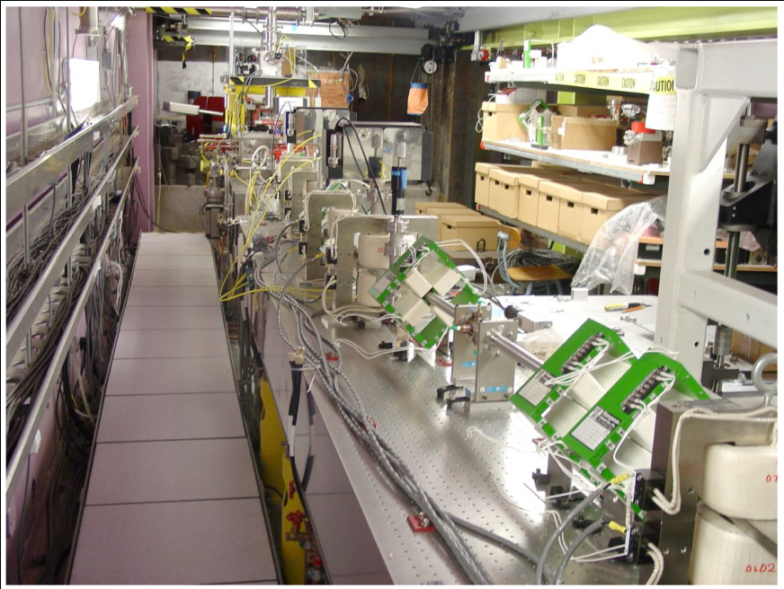
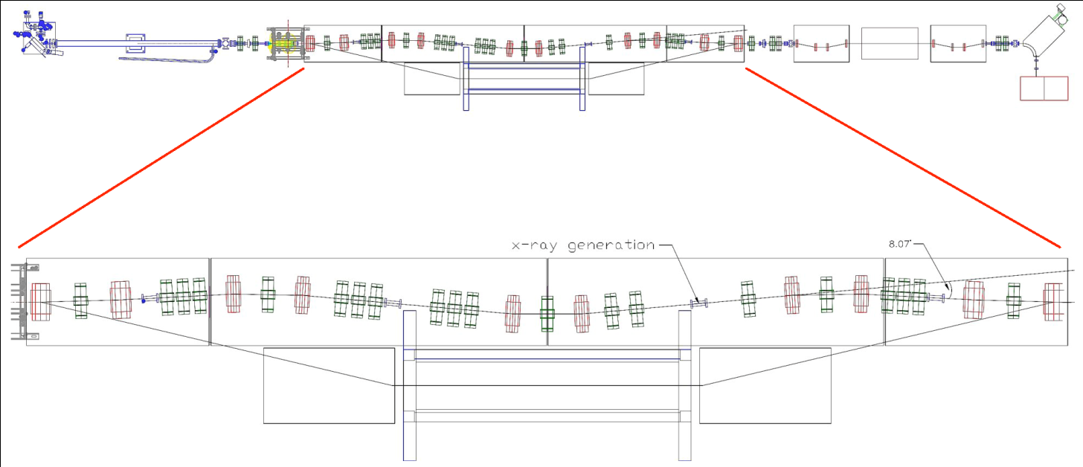
Bremsstrahlung x-ray source: UH FEL
Charged particle (beam bunch) direct production
Target:
Thin
Cu foil
Vacuum
Al Exit
Window
Helium filled transport line
Plastic cover`
FR-4 (PCB)
Active Si
Bulk Si
Carrier
Air
1 mil
~15”
300 um
8 mil
1mm
200 um
10 mil polyethylene
2.4um
62.5 mil
x-rays
Pop-in target (Mike Hadmack poster for details)
3

Slide 4
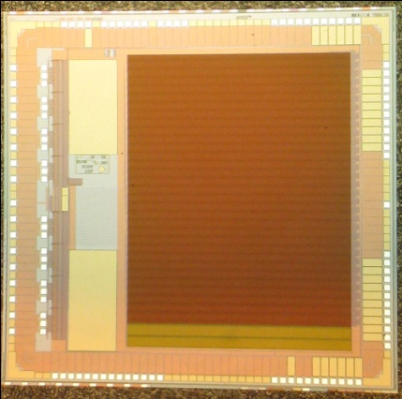
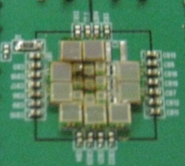
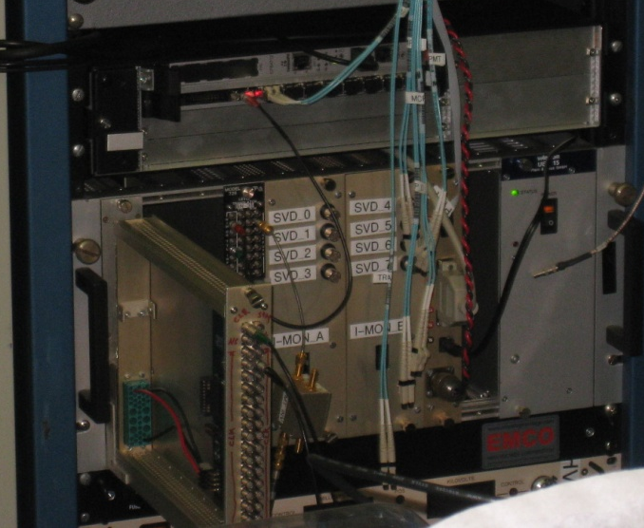
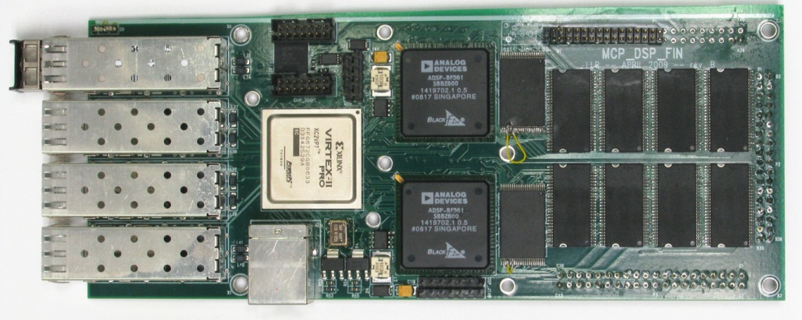
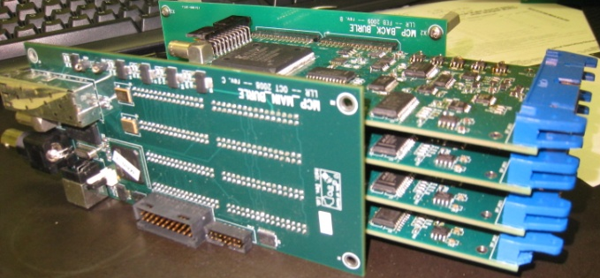
x-ray beamline Instrumentation: PA/HEP experience
cPCI crate (control room)
ASICs
New
card
Detectors
CPU
X-rays
Front-end
Module
Master
Module
Giga-bit
Fiber links
Master module
4

Slide 5
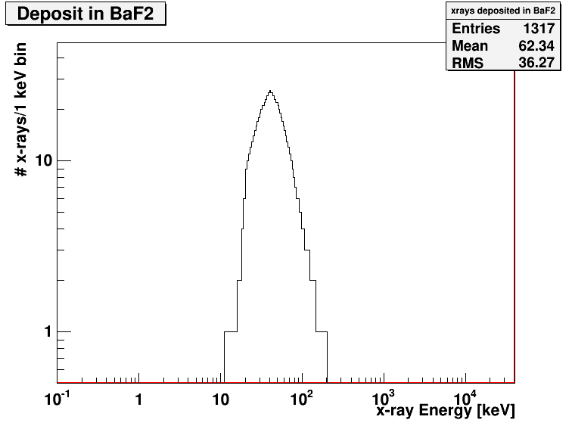
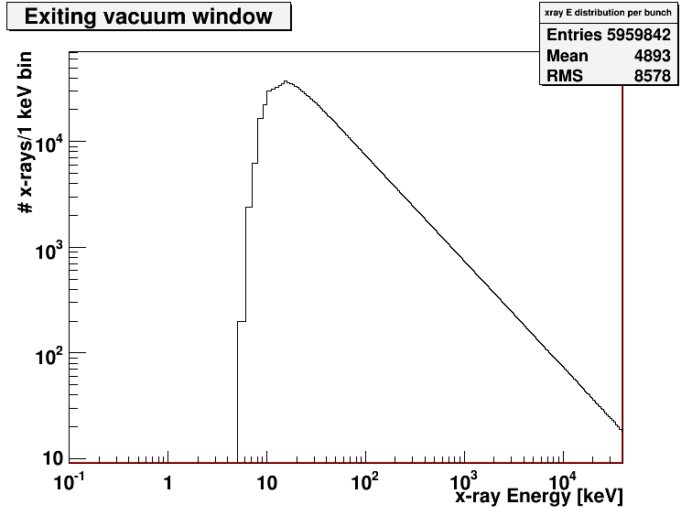
Sample result of beam transport simulation
Target:
Thin
Cu foil
Vacuum
Al Exit
Window
Helium filled bag/volume
Plastic cover`
BaF2 radiator
Active Si
FR-4 (PCB)
Ebeam = 40MeV
<I>=200mA
Bulk Si
Carrier
Air
e-
10 mil BaF2
1 mil
~15”
300 um
8 mil
1mm
200 um
10 mil polyethylene
2.4um
62.5 mil
Mean energy:
60-70keV
Single ps bunch
5

Slide 6
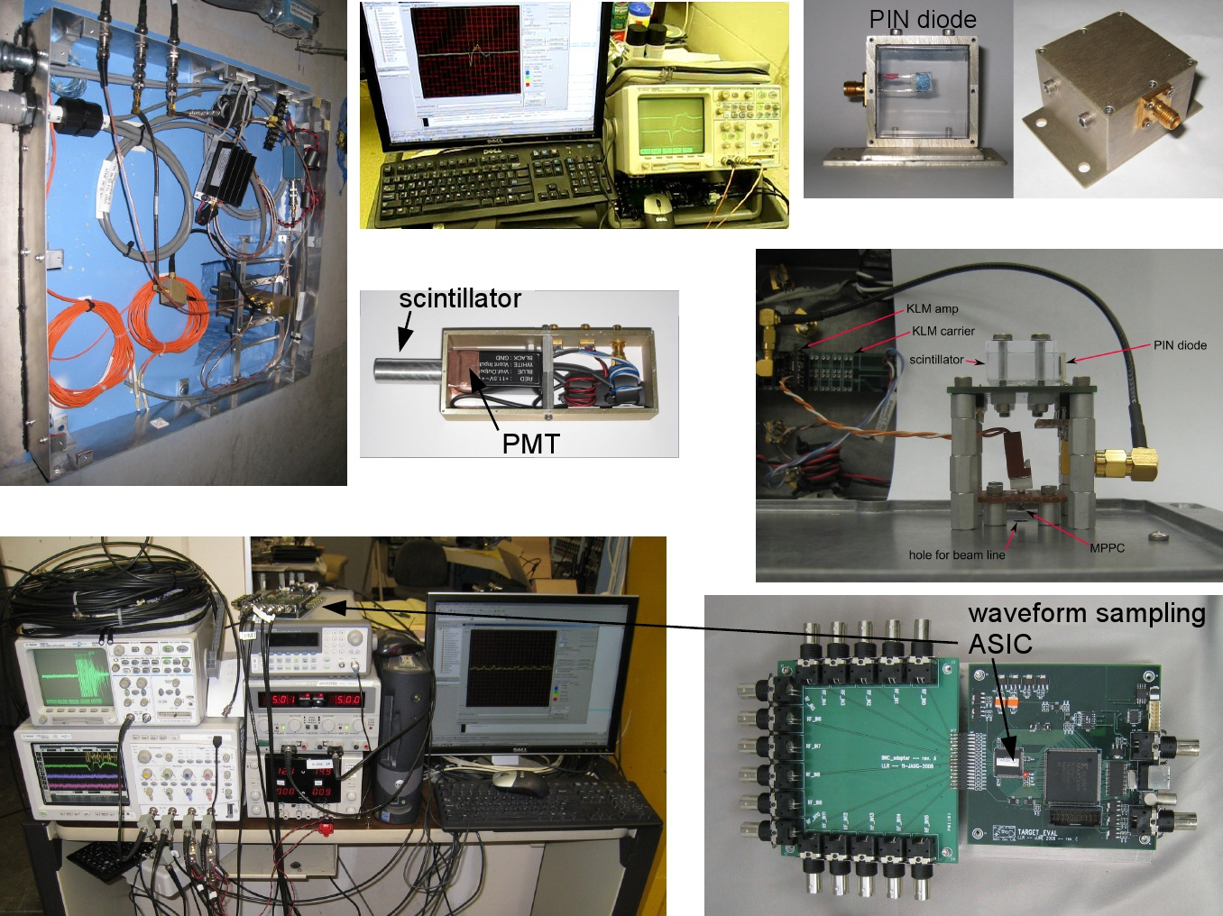
16-channel 2.5GSa/s
TARGET digitizer ASIC

Slide 7
Initial Runs – “first light”
Production Target Out
Production Target In
Low background when beam on but Cu foil out
AC-coupled: fit to extract pulses
7

Slide 8
Results from Run 377-500 (Exp 2a)
Foil In
~17.5 70keV x-rays/ps bunch
Energy deposition
(lower bound)
8

Slide 9

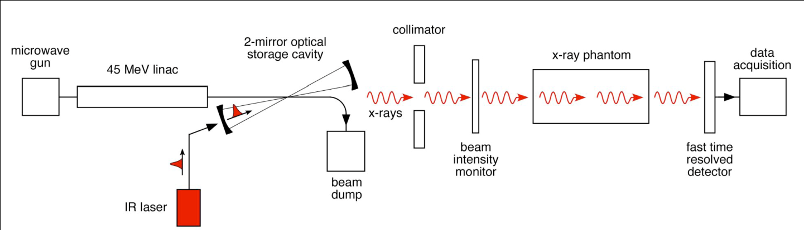
Phase II: tunable, Mono-chromatic x-ray Source
3rd Generation x-ray source (Eric Szarmes poster for details)
2nd Generation x-ray source (Mike Hadmack poster for details)
9

Slide 10
Evolution of beamline instrumentation
Sensors (detectors)
  Base first iteration on commercially avail parts
  Develop tailored Si sensor devices
Custom Readout chips
  Using existing GSa/s transient digitizers initially
  Develop optimized ASICs for project
High speed DAQ protocol
  Leverage concurrent development for Super B-factory, large cosmic stand readout
Modular system (expandable)
cPCI crate (control room)
ASICs
XMC
Detectors
CPU
X-rays
Front-end
Module
Master
Module
Fiber links
10

Slide 11
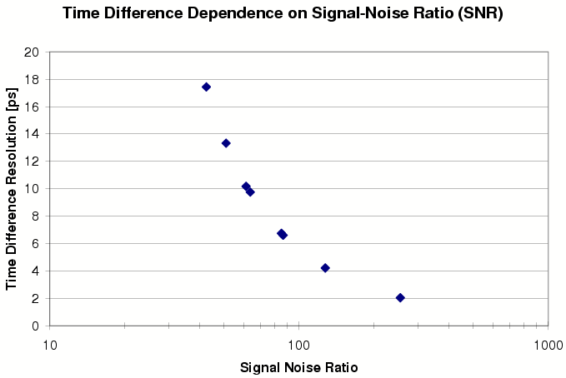
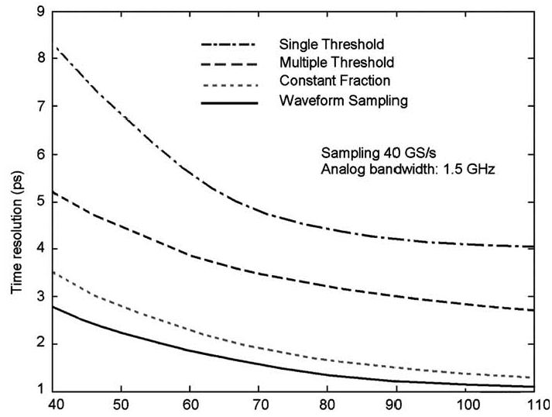
1ps timing?
Detector & Front-end Electronics studies
1GHz analog bandwidth, 5GSa/s
Simulation includes detector response
G. Varner and L. Ruckman
NIM A602 (2009) 438-445.
J-F Genat, G. Varner, F. Tang, H. Frisch
NIM A607 (2009) 387-393.
11

Slide 12
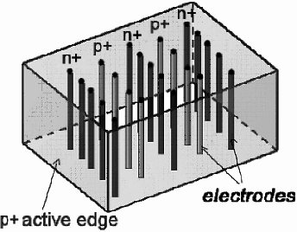
Fast Detector Options
signal electrodes with contact pads to readout
200 – 300 µm
active edges
beam in
Next generation available in Mid-May
To be tested in Exp 5
12

Slide 13
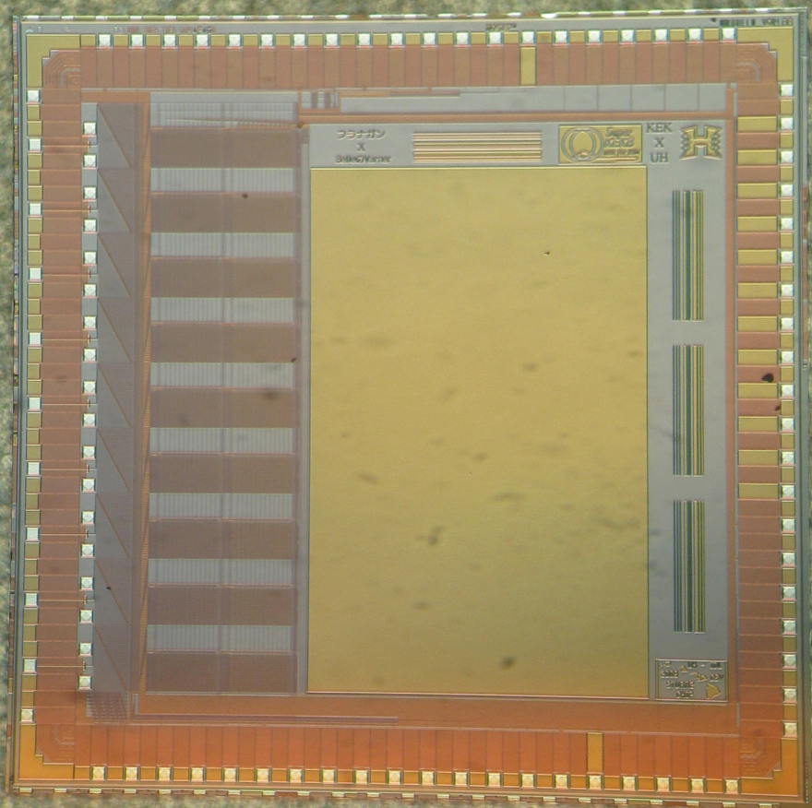
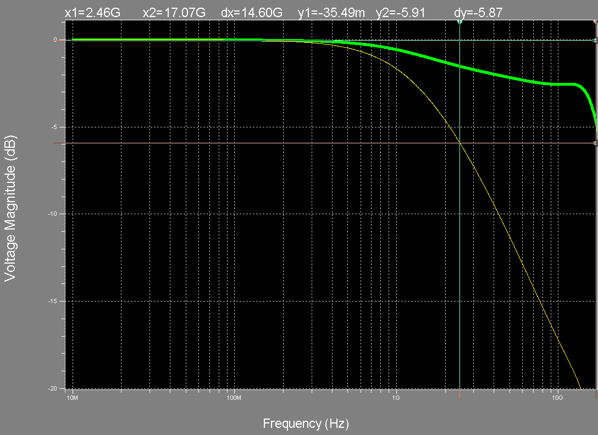
STURM2 Prototype (evol. Step)
“Max bandwidth/throughput”
Specifications
ASIC under study
~20GHz (onto ASIC)
2.5GHz (into storage cell)
13

Slide 14
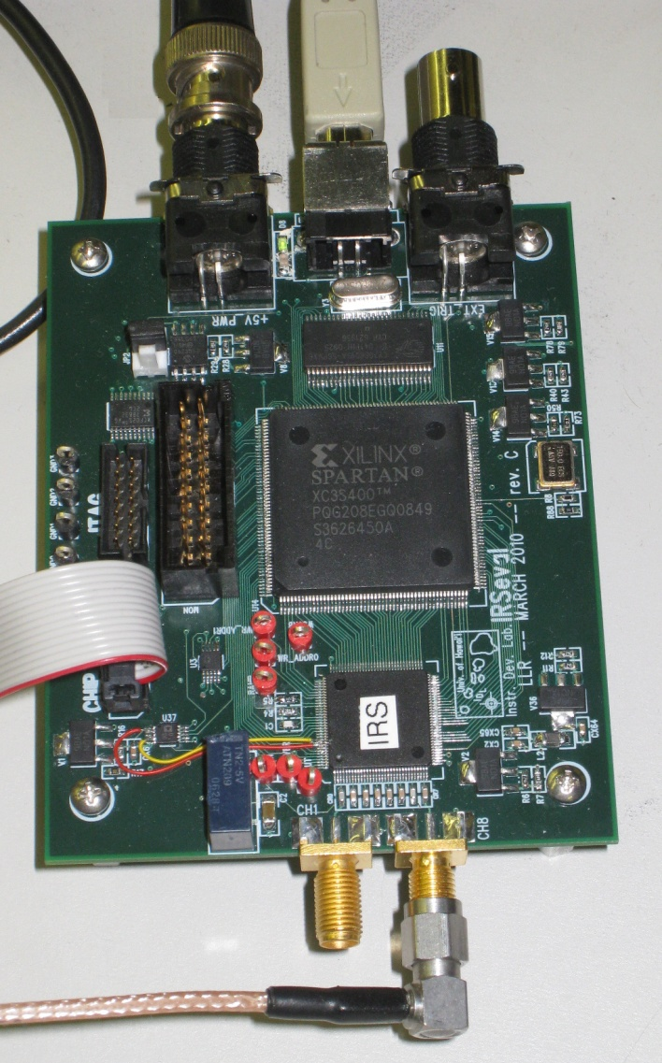
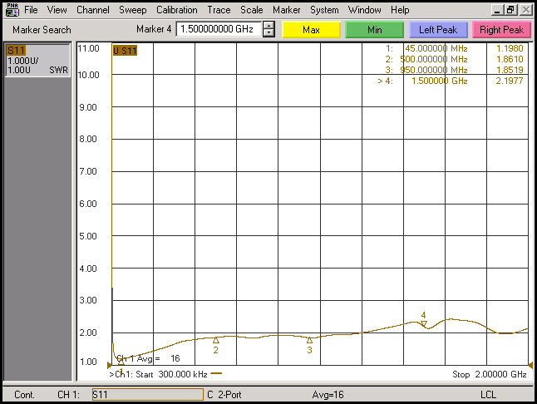
32k Deep storage ASIC RF input coupling (S11)
Excellent input coupling
14

Slide 15
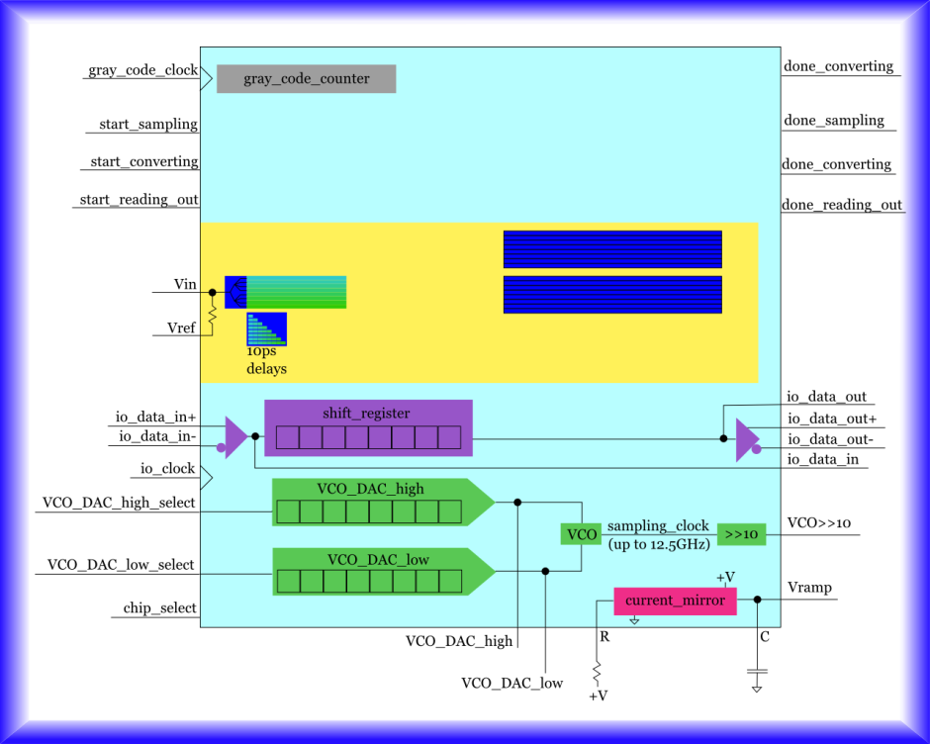
Next Generation ASIC
10us long “streak camera” (1M points sampling)
15

Slide 16
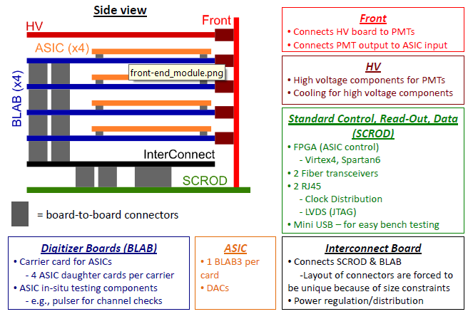
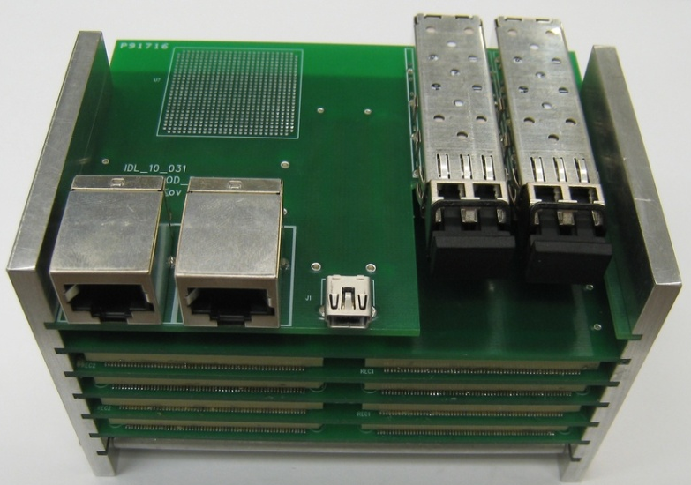
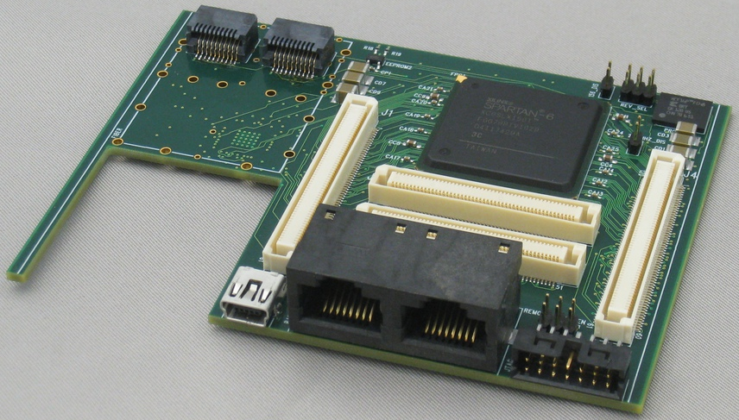
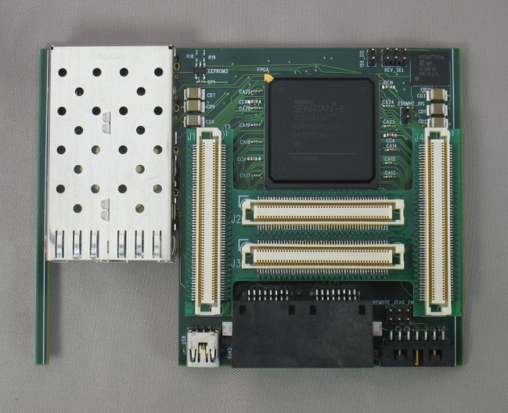
Front-end, compact, fast readout
16

Slide 17
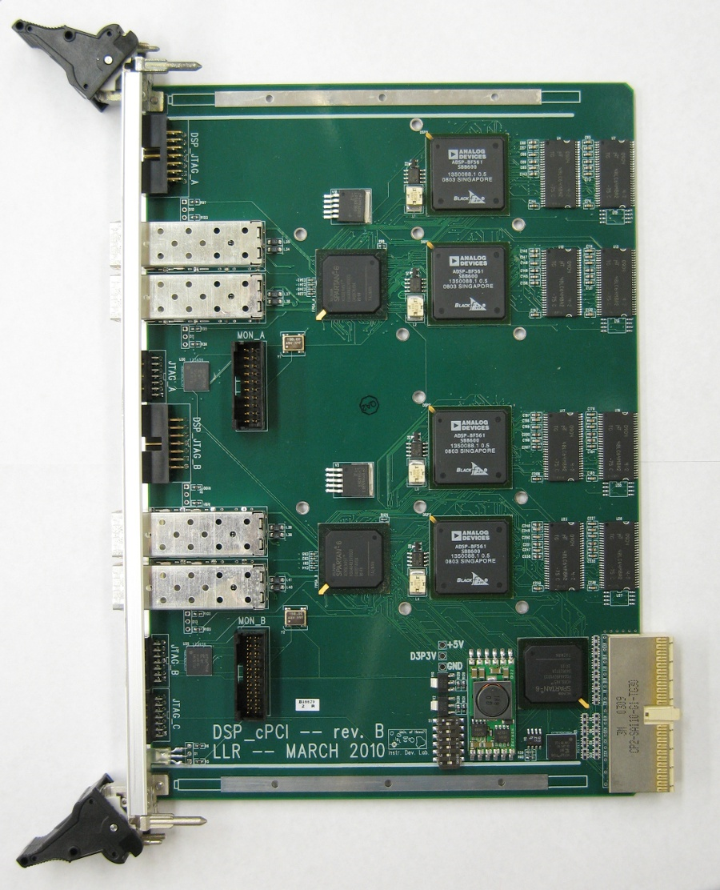
Back-end: high throughput DAQ
4x Analog Devices Black-Fin Digital Signal Processing chips
(prompt data reduction)
4x 3Gbps bi-directional optical fiber links (from front-end)
Dedicated server for real-time data quality display and archiving (RAID array)
Standard compact PCI format (expandable)
17

Slide 18
Summary
Great progress – first x-rays!
Next step: incremental improvement all fronts
Next generation of x-ray detectors (thick Si trench electrodes, CZT)
Improved sampling speed, deeper storage ASICs
Commission multi Giga-byte/s data transfer/archiving
Fast feature extraction/real time data reduction algorithm development
18

