Slide 1
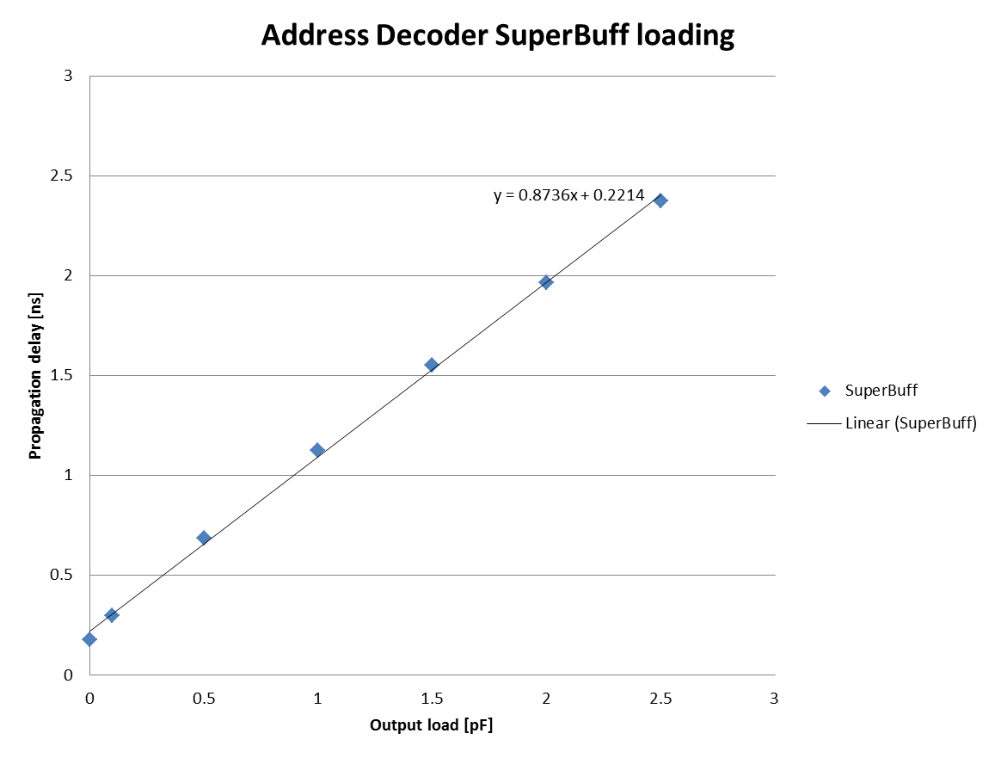
Gary Varner (IRSX delay simulations)
Progress
Simulation of delays, including loading
Capacitance estimate for Address Decoder
Input to Verilog simulation (Luca/Nalu)
Plans
Get example implementation from Luca
Study and try to apply
Compare with IRSX measurements (Oskar)
22-JUN-2020

