Slide 1
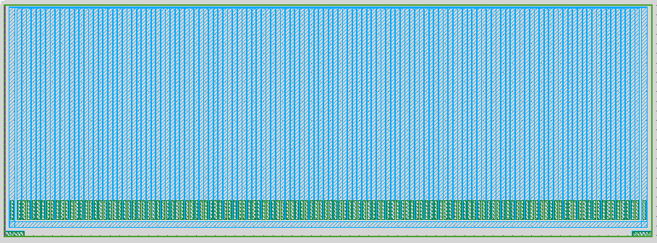
strip detector with surrounding guardring
Dimension Details
Entrance window for x-rays
2415um
6750um (active edge boundaries)
6500um active width (130strips x 50um)

Slide 2
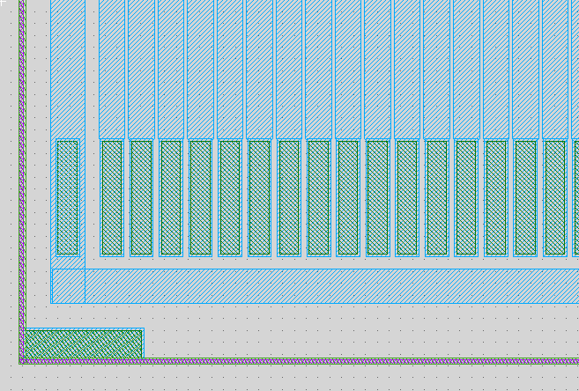
Pad layout for strip detector w/surrounding Guard Ring
Guard ring
Pad opening
32umx192um
Pad opening: 32umx192um
Backside contact: opening 196um x 46um, both left and right bottom corner

Slide 3
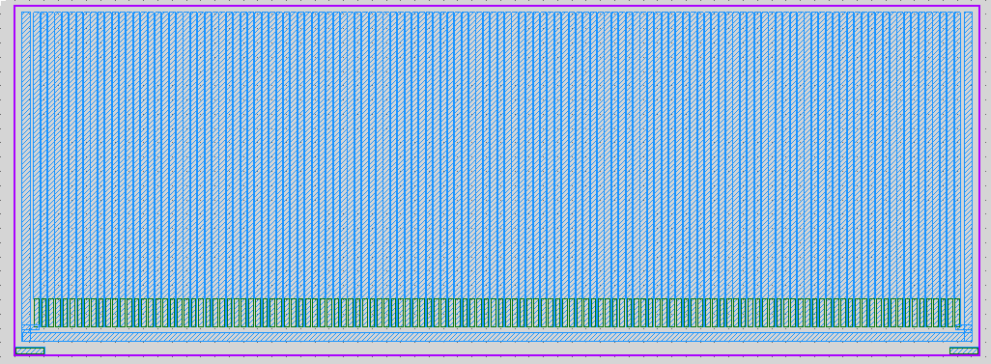
Cross section of GR device
Active device on support substrate
2415um
2415um
75um
(plasma diced)
50um-100um?
Active device
Support substrate
300um
(wafer-saw)

