Slide 1
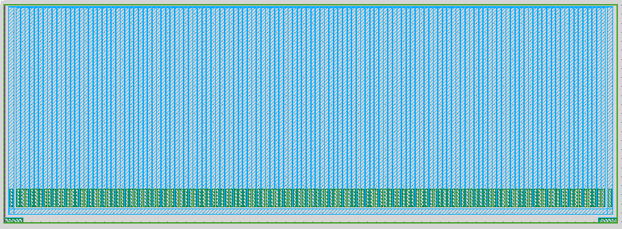
strip detector with surrounding guardring
Dimension Details
Entrance window for x-rays
2415um
6750um (active edge boundaries)
6500um active width (130strips x 50um)

Slide 2
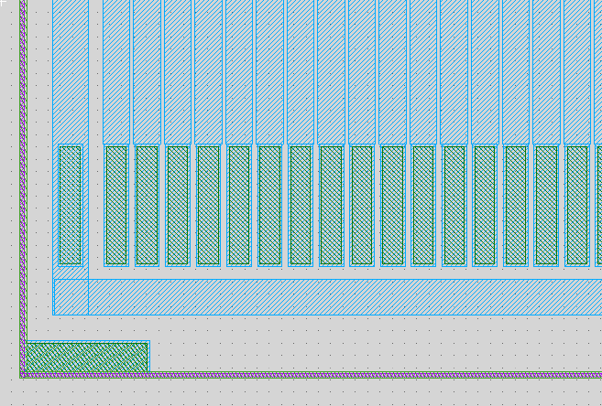
Pad layout for strip detector w/surrounding Guard Ring
Guard ring
Pad opening
32umx192um
Pad opening: 32umx192um
Backside contact: opening 196um x 46um, both left and right bottom corner

Slide 3
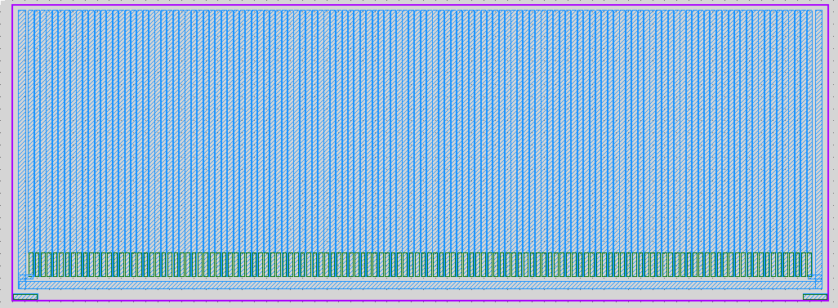
Cross section of GR device
Active device on support substrate
2415um
2415um
75um
(plasma diced)
50um-100um?
Active device
Support substrate
300um
(wafer-saw)

Slide 4
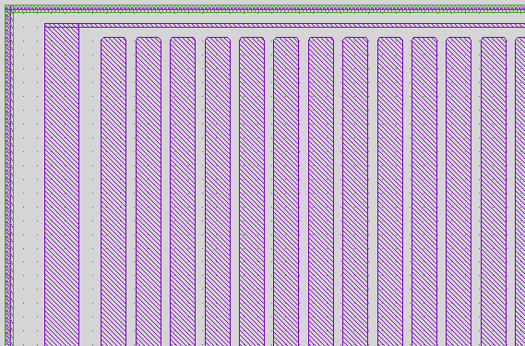
Strip Detector w/Surrounding guard ring: entrance window
“Dead” region = guard ring width + distance from guard ring to edge + ½ distance from guard ring to pixel =33um
From guard ring to entrance window: 20um
Guard ring: 5um wide
Dead region boundary
From guard ring to pixel: 15um

Slide 5
Old Baseline strip detector: 3-sides guard ring
Entrance window for x-rays
2445um
6750um (active edge boundaries)
6500um active width (130strips x 50um)
-2 outer strips tied to guard-ring

Slide 6
Cross section of old baseline device
Active device on support substrate
2445um
2445um
75um
(plasma diced)
50um-100um?
Active device
Support substrate
300um
(wafer-saw)

Slide 7
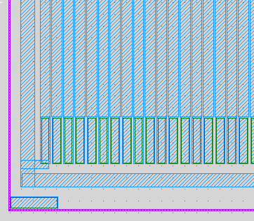
Old Baseline strip detector
Strip pitch: 50um
130 pixels, active width = 6500um
Pad opening: 32umx192um
Guard ring contact
Backside contact: opening 196um x 46um, both left and right bottom corner

Slide 8
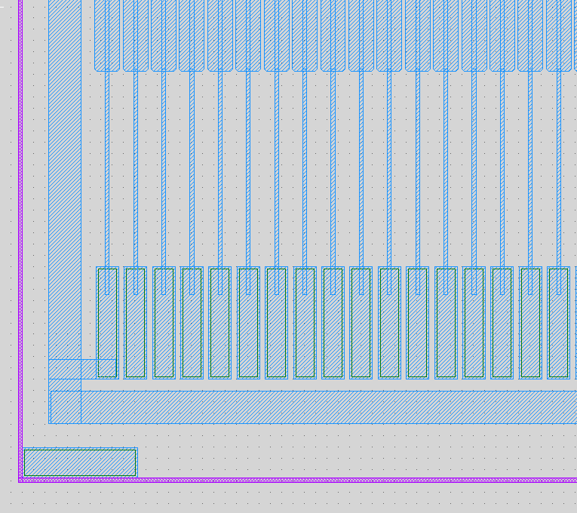
Old Baseline w/extra distance
Topcell: top_extra_pad_distance
Extra 350um
Total height 2775um
Guard ring contact
Backside contact: opening 196um x 46um, both left and right bottom corner

Slide 9
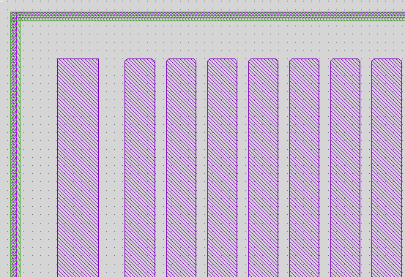
Old Baseline entrance window (with or without extra pad distance)
Pixel diffusion starts 50um from entrance window, but “dead” region would be limited to sidewall p-diffusion on entrance window, ~1um
From pixel diffusion to entrance window: 50um

