Slide 1
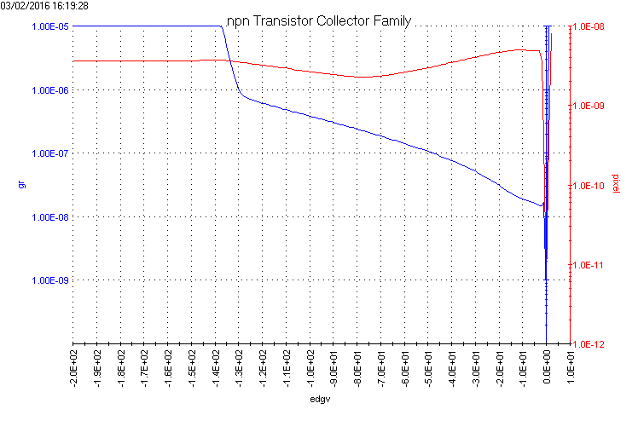
Kekb strip detector: guard ring and middle pixel biased: both devices from top of wafer. Note: actual pixel leakage will be much lower with all pixels biased
Blue is guard ring current (left axis)
Red is pixel current (right axis)
Detector with “full” guard ring
<1nA pixel leakage
Edge/backside voltage
Detector with “3-sides” guard ring
~3nA pixel leakage

