Slide 1
Active Edge Strip Detector Dark Current Results
J. Hasi and J. Segal 6/15/16

Slide 2
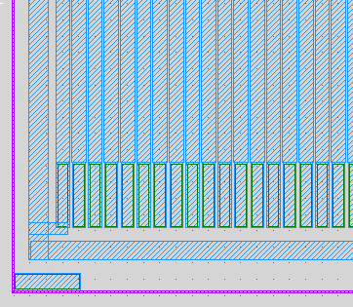
Old baseline strip detector: No guard ring at entrance window
Pixel
Guard ring
Backside contact

Slide 3
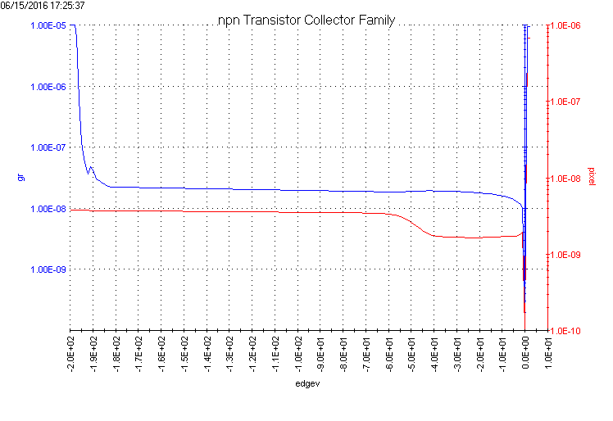
Old baseline Strip Detector
Pixel current will be lower when all pixels are biased
Guard ring current
Single pixel current
Backside bias

Slide 4
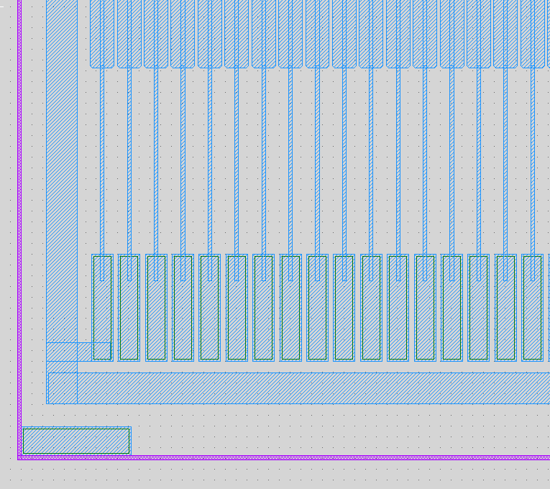
Old Baseline w/extra distance for stacking
Extra 350um
Pixel
Guard ring
Backside contact

Slide 5
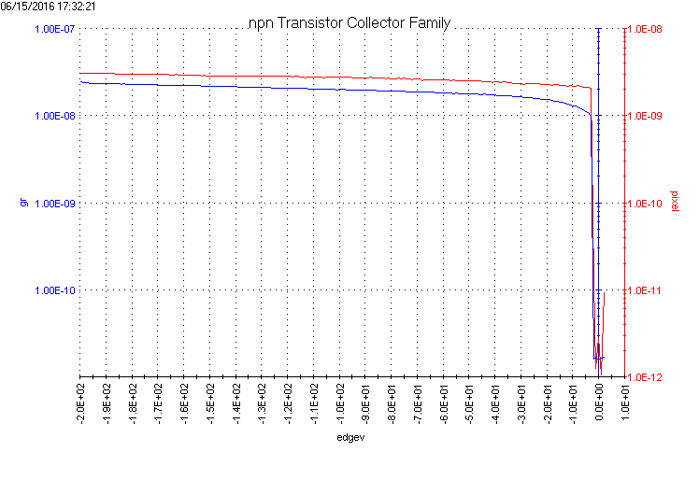
Extra-distance Strip Detector
Pixel current will be lower when all pixels are biased
Guard ring current
Single pixel current
Backside bias

Slide 6
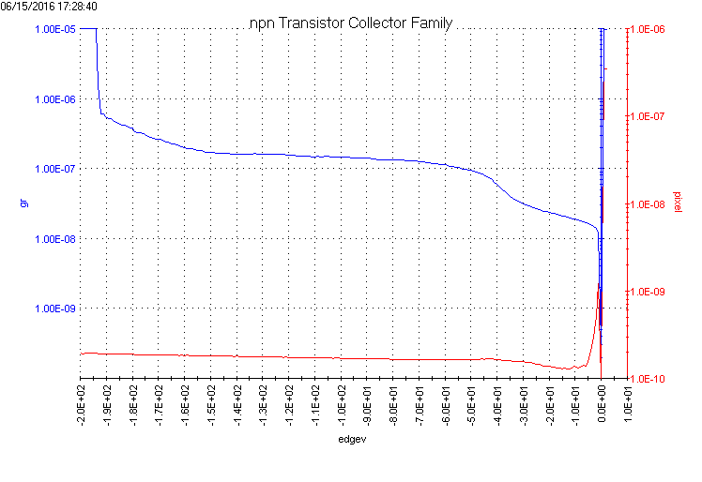
Guard Ring Surrounding Strip Detector
Pixel current will be lower when all pixels are biased
Guard ring current
Single pixel current
Backside bias

