Slide 1
X-ray spectra for different mask substrate types and gold thicknesses
J.W. Flanagan
XDET Mtg.
2013.10.3

Slide 2
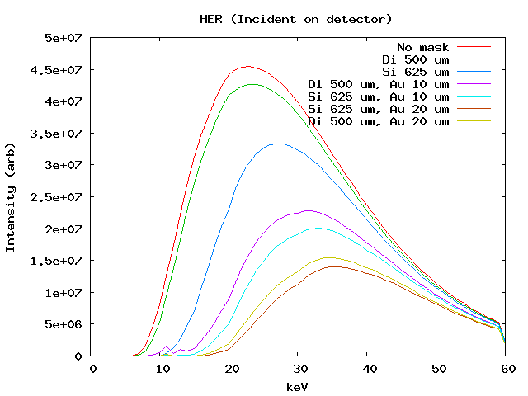
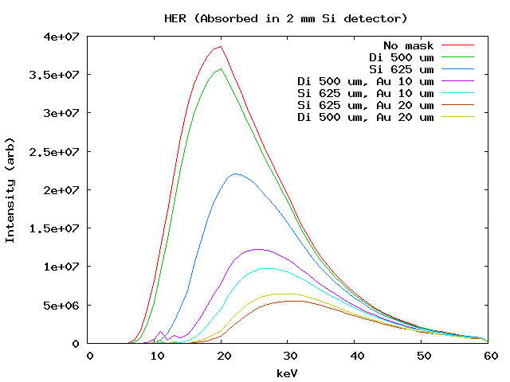
HER
Power incident on face of detector
Power absorbed in 2 mm-deep Si detector
Also assume 1.42 cm of Be in path

Slide 3
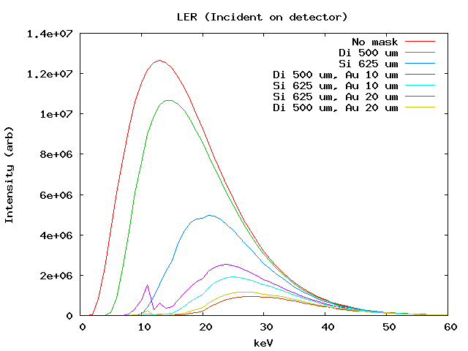
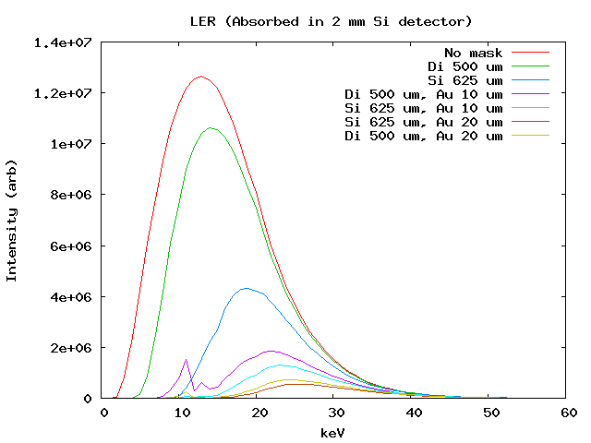
LER
Power incident on face of detector
Power absorbed in 2 mm-deep Si detector
Also assume 200 um of Be in path

