Slide 1
Overview of KLM Crate Utilization
Belle Crate Configuration shown
Plan is to re-use locations, but with the following changes:
All endcap 6U crates are removed
8 new 9U (COPPER) crates for endcap are installed (4x each end, 2x each door)
4 new 9U (COPPER) crates for barrel scint are installed (BF4, BF0, BB4, BB0)
ARICH and TOP FTSW located in 8 crates (BF0 .. BF7) and (BB0 .. BB7) respectively

Slide 2
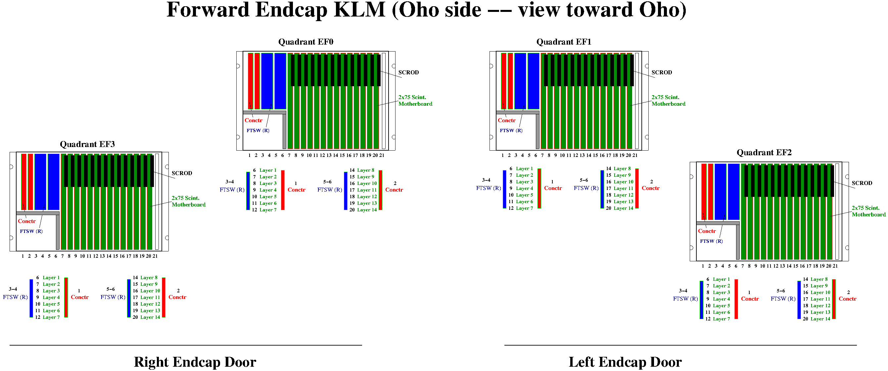
Forward
Endcap (Scintillator) KLM

Slide 3
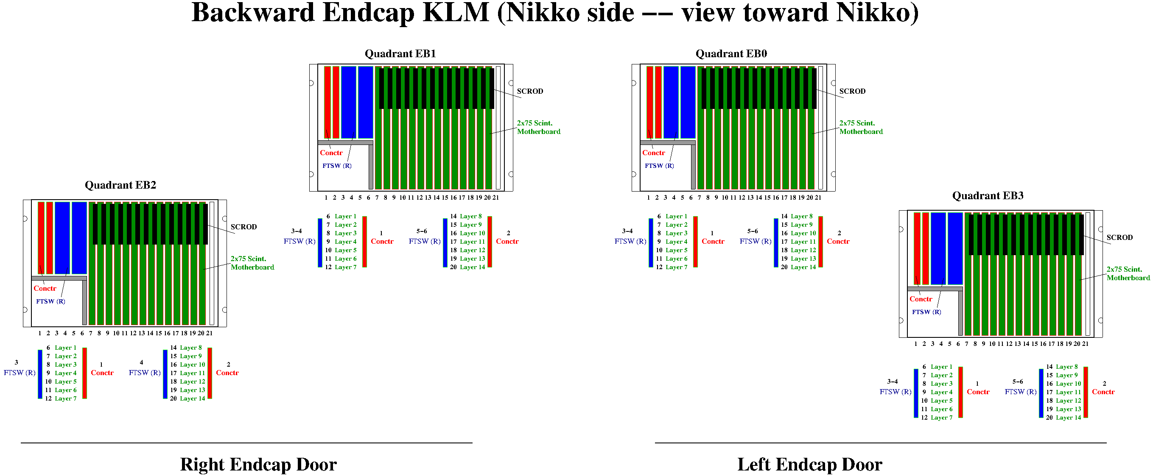
Backward
Endcap (Scintillator) KLM

Slide 4
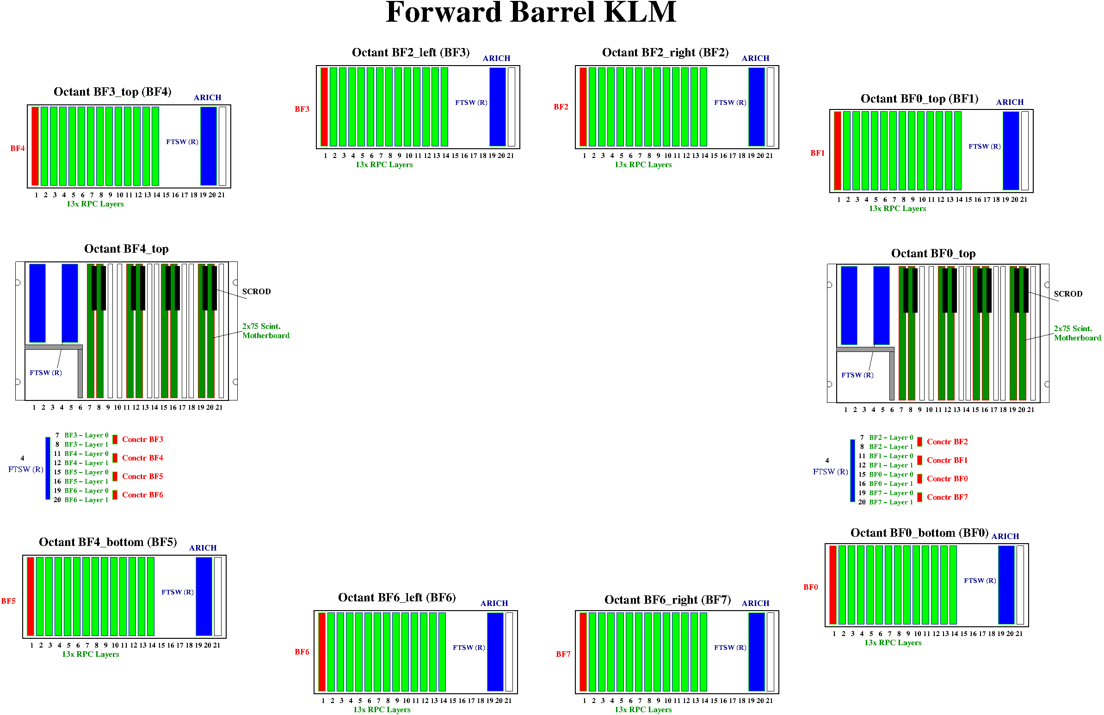
Forward Barrel KLM
Octant BF2_left
Octant BF2_right

Slide 5
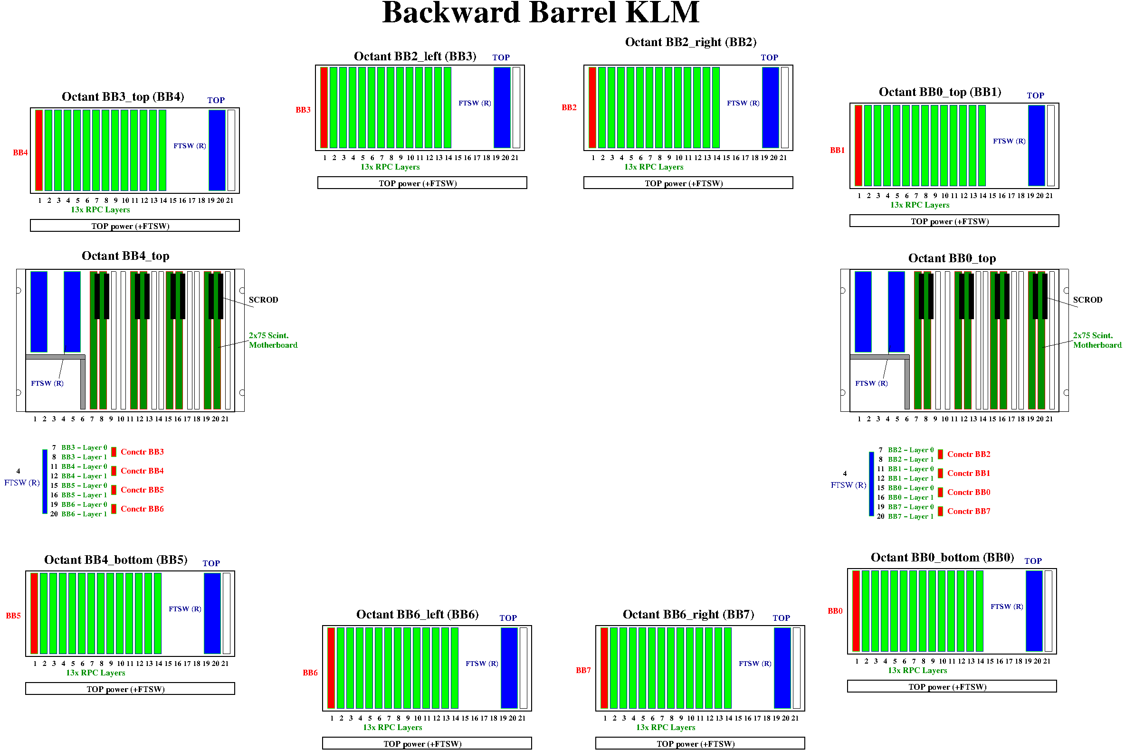
Backward Barrel KLM
Octant BB2_left
Octant BB2_right

