Slide 1
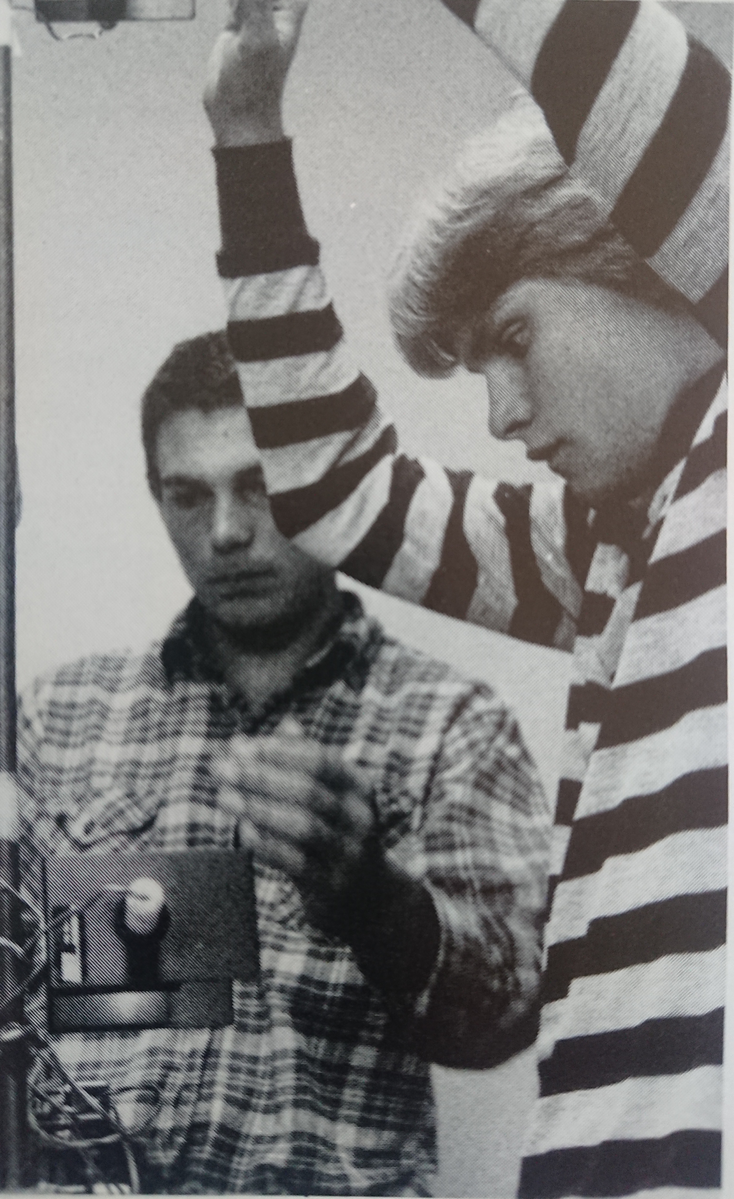
Gary Varner in 1984: High School Physics
Motivation: Extra credit
Objective: Measure earth’s gravitation
Method: Time free-fall of metal ball
Apparatus (at right):
Two lamps/photodiodes and digital timer
Result: Not too accurate (vs. 9.8 m/s²)
Discussion:
There were some gaps in our experimental technique, statistics, and error analysis

Slide 2
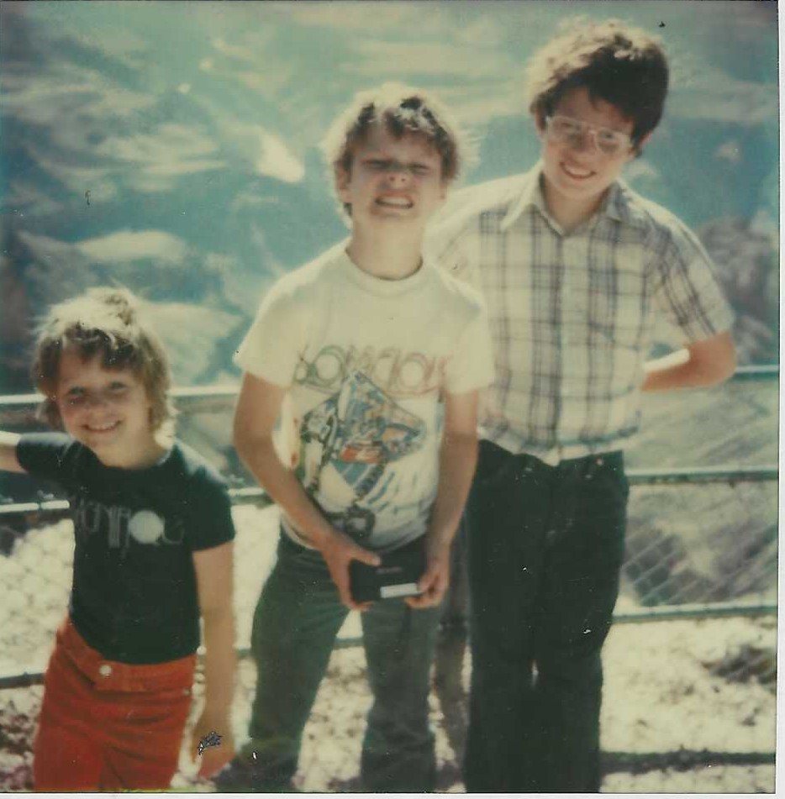
Gary and Family
Dad: Sim
Mom: Elaine
Gary
Tim
Alexis
(+Grandma)

Slide 3
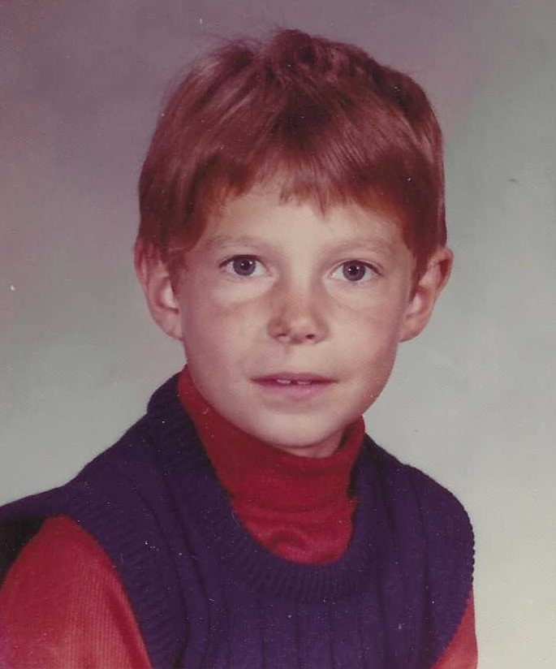
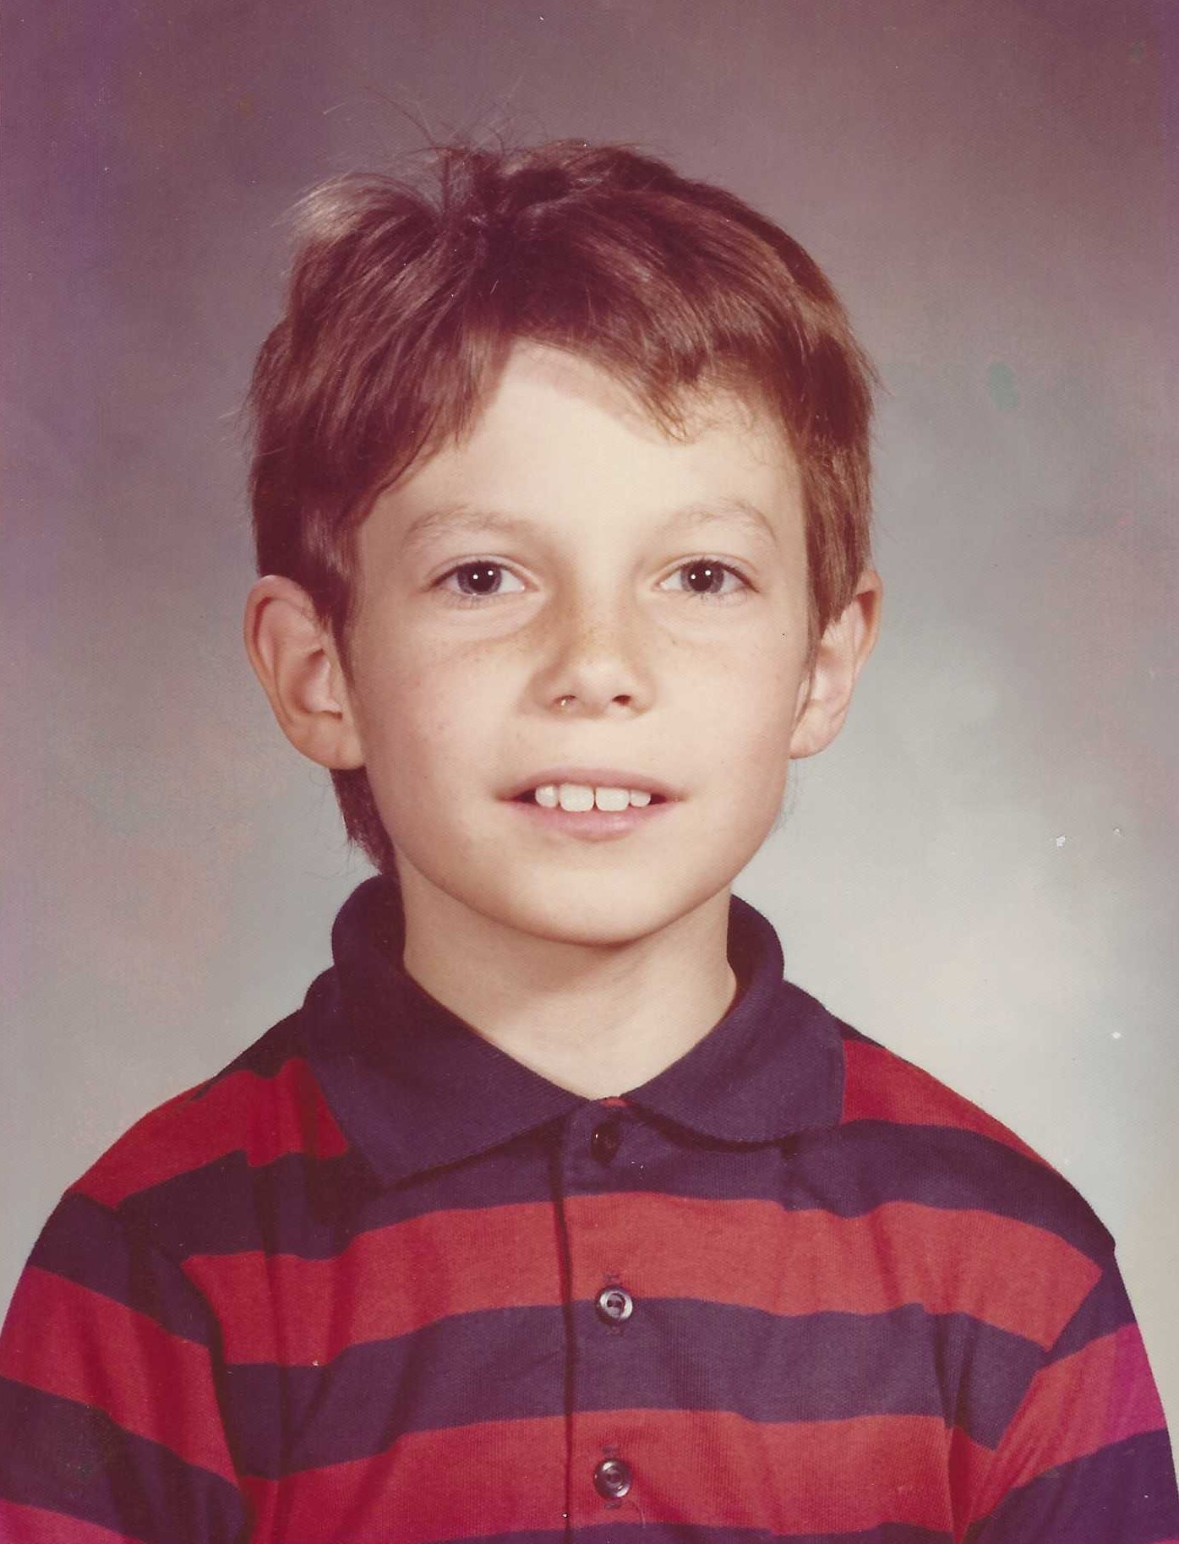
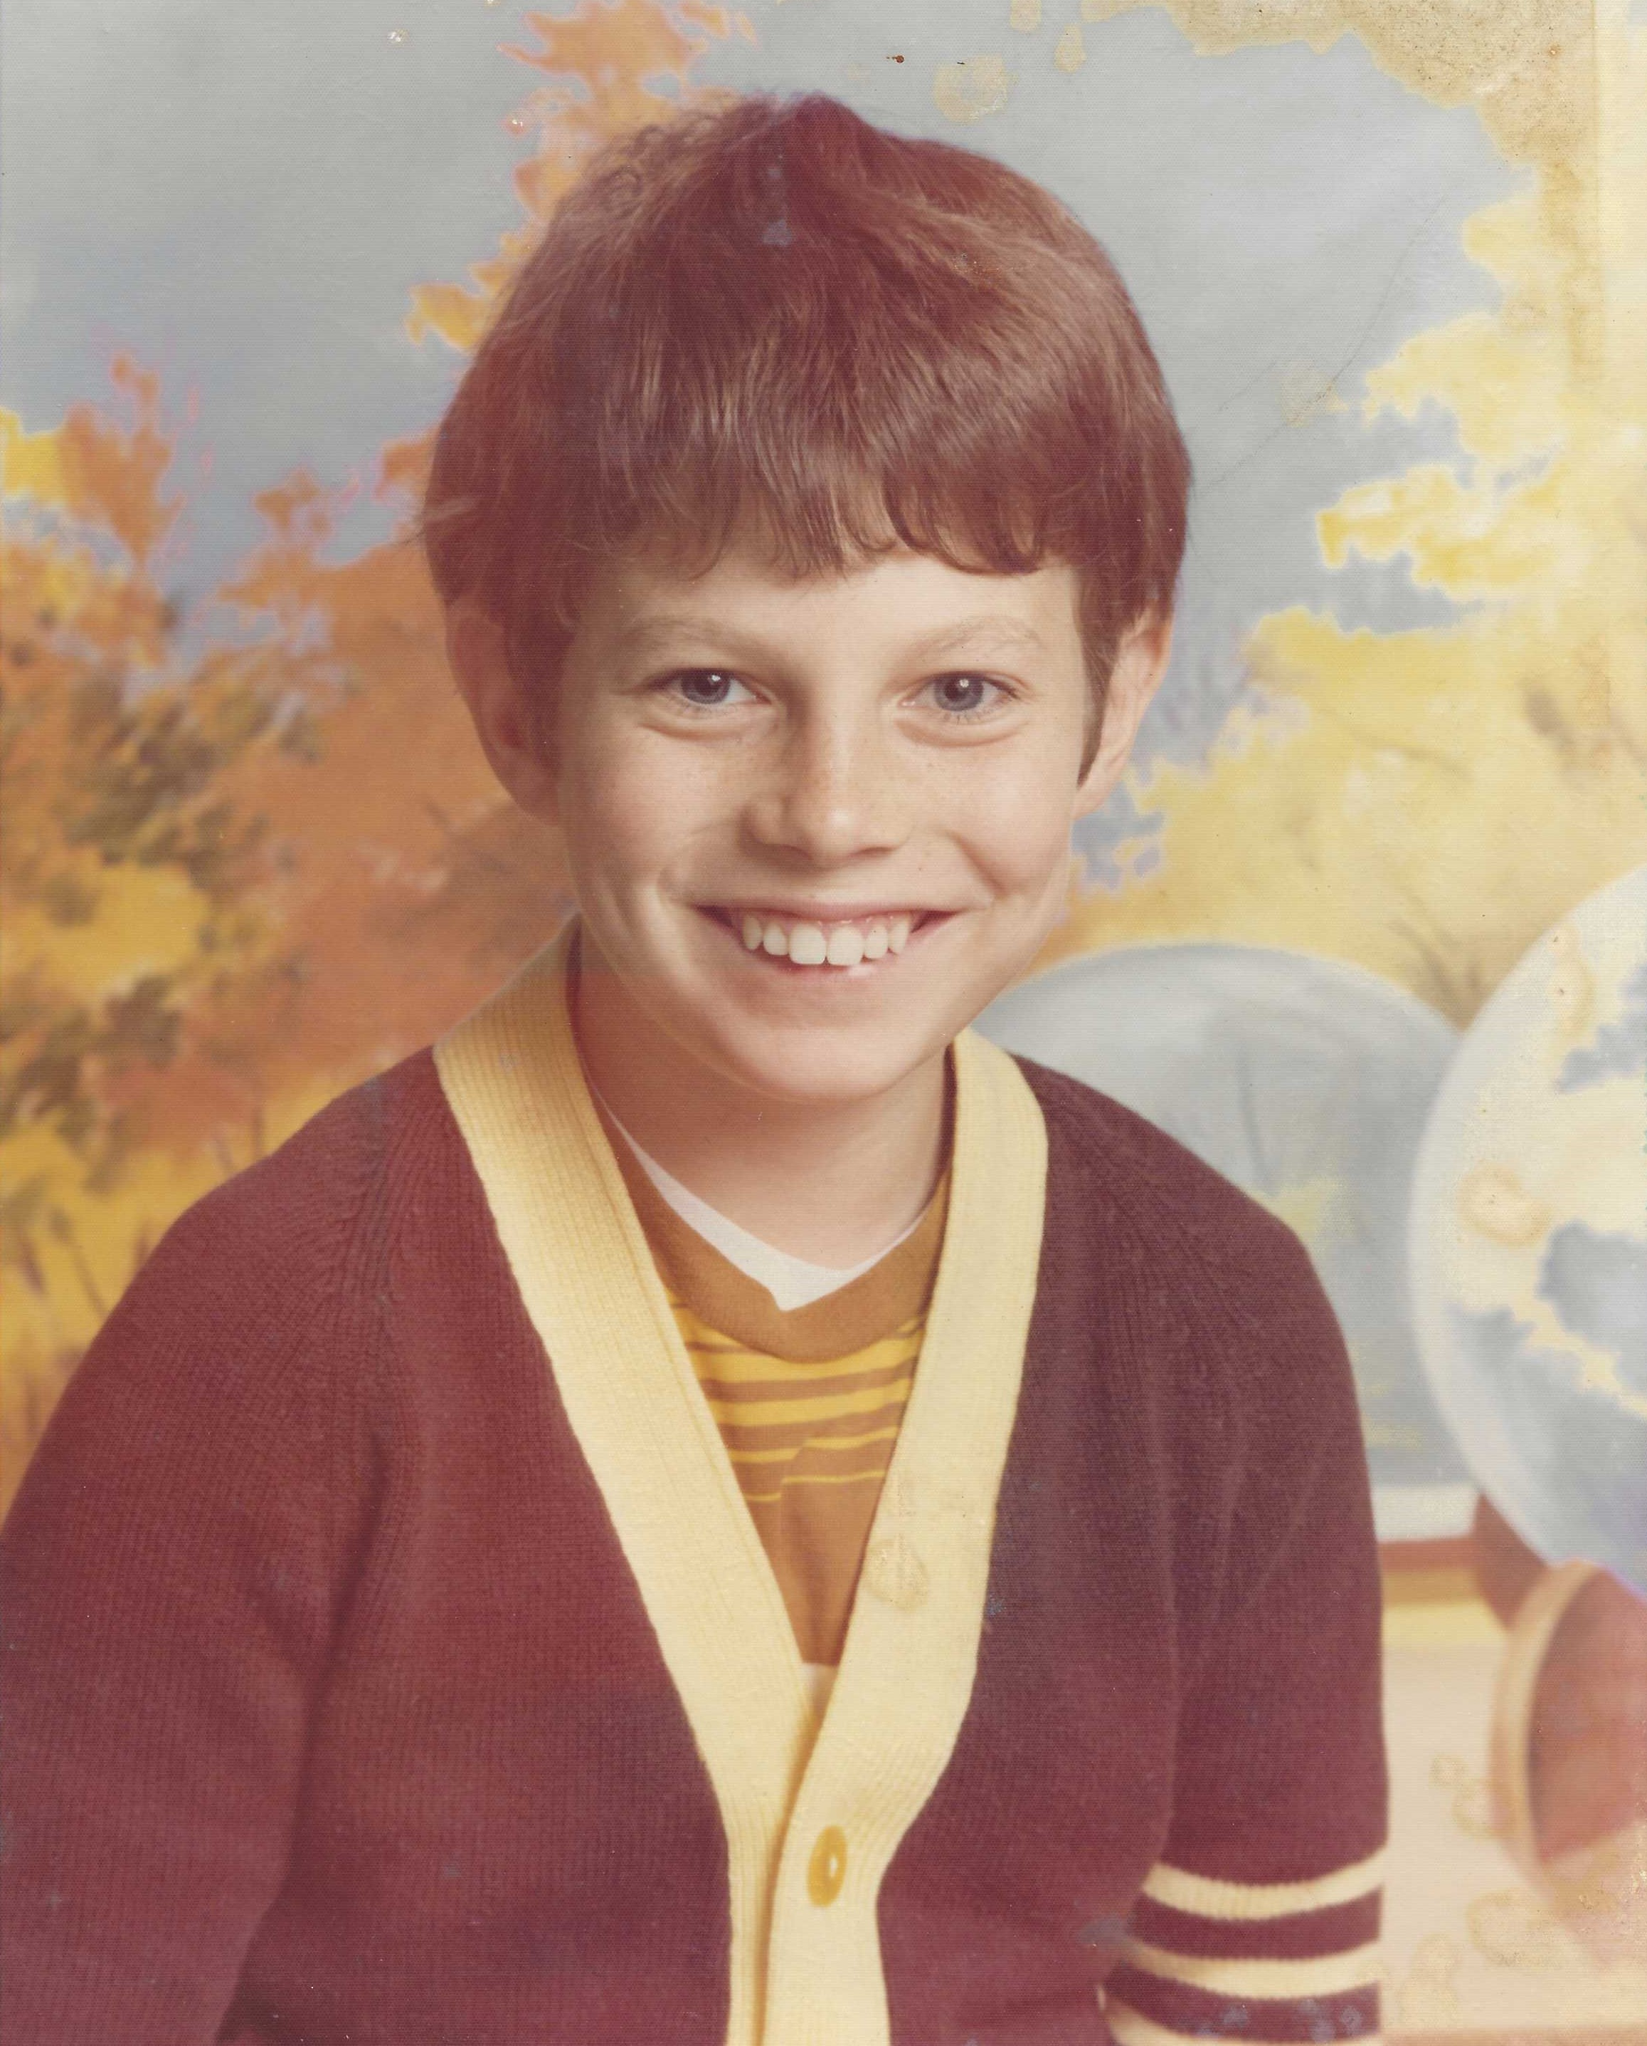
Gary as a kid

Slide 4
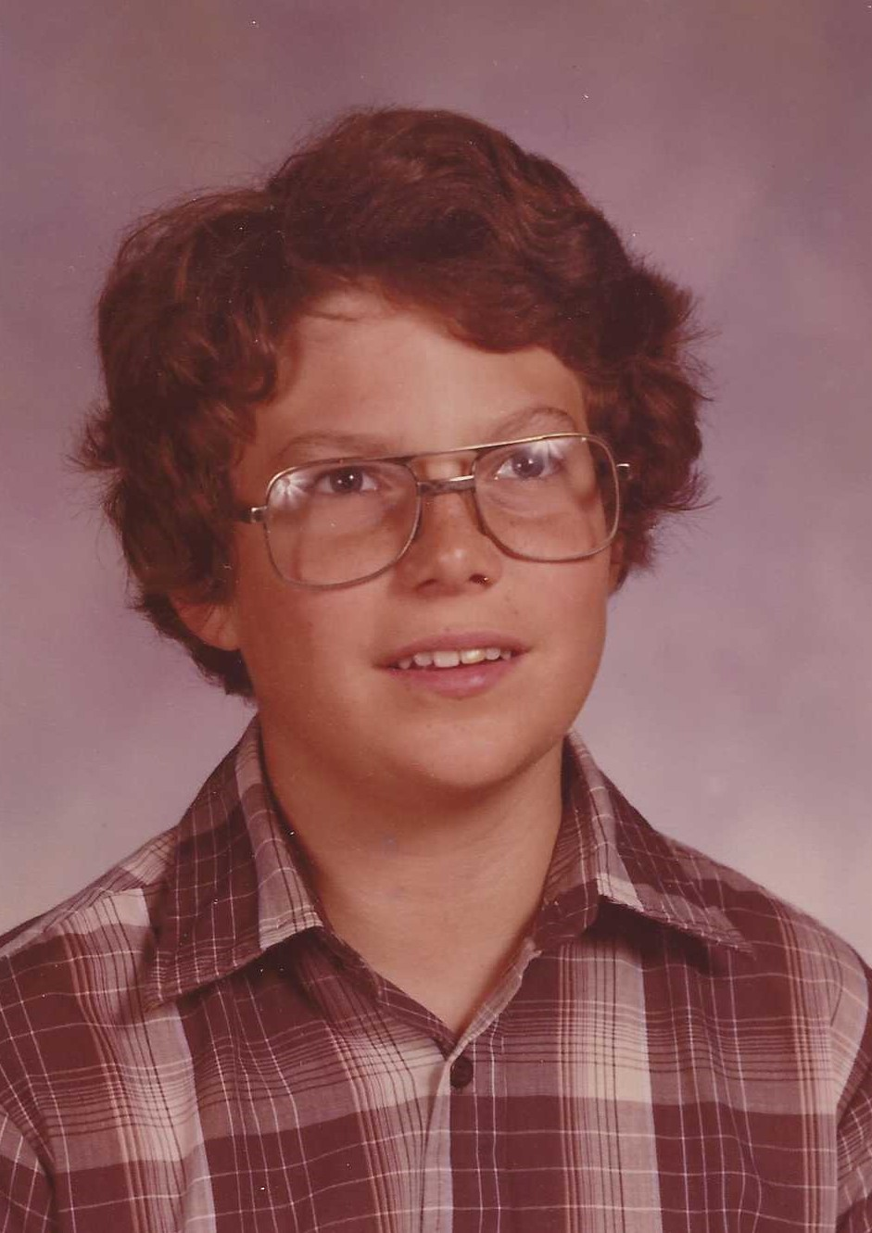
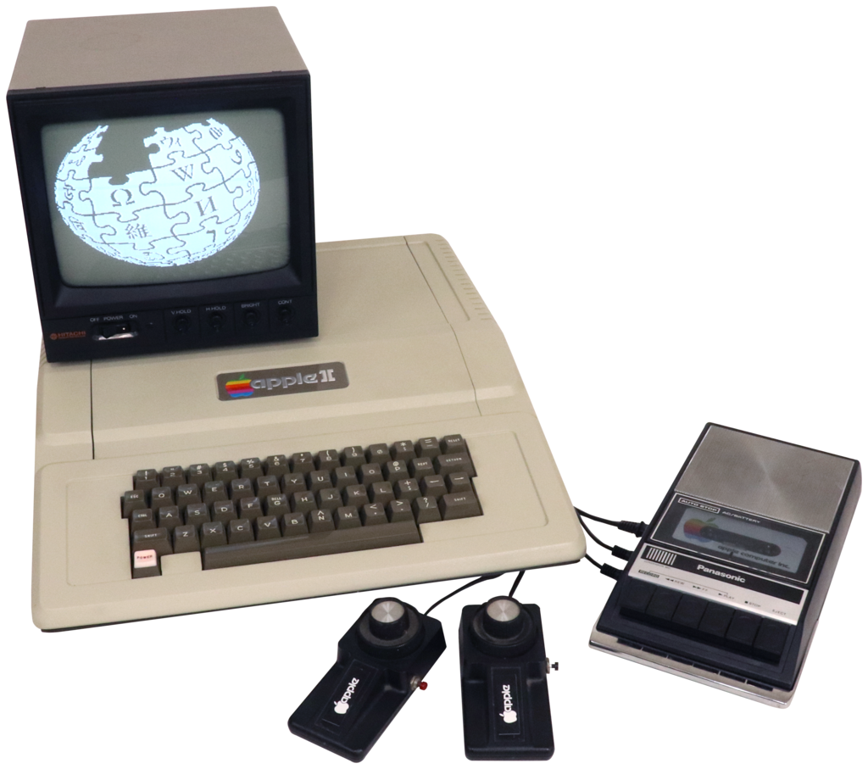
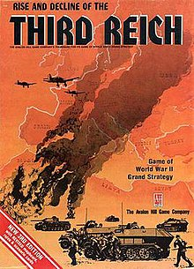
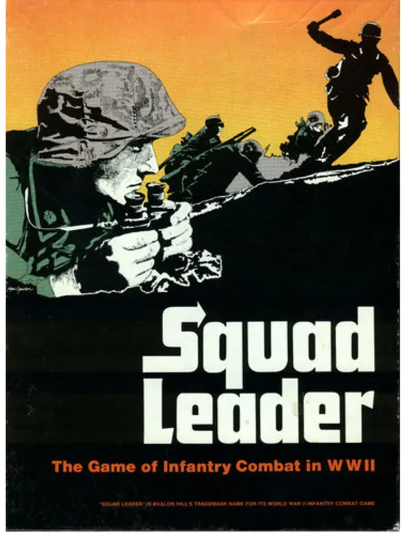
Our Paths intersect – shared geekdom
Gary at 14

Slide 5
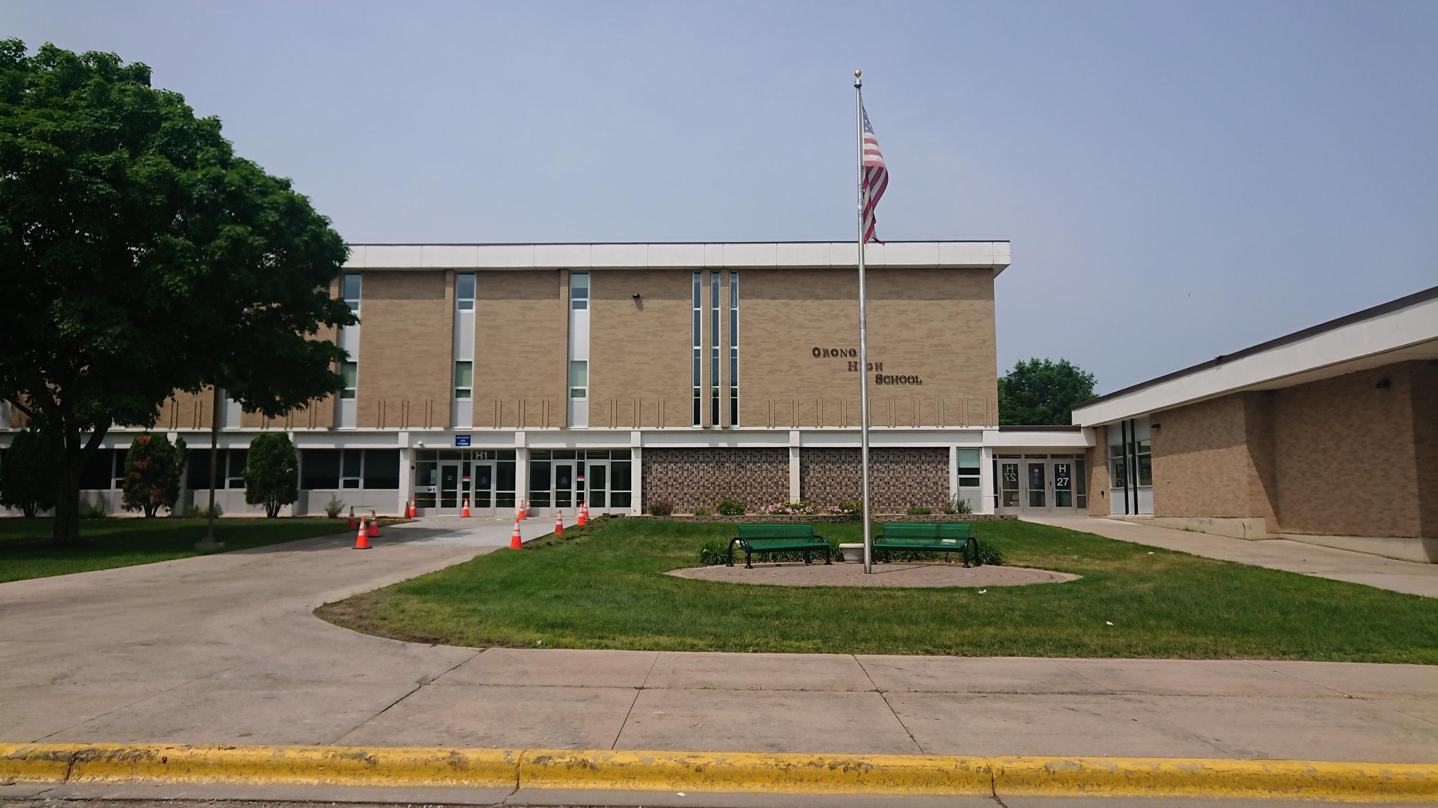
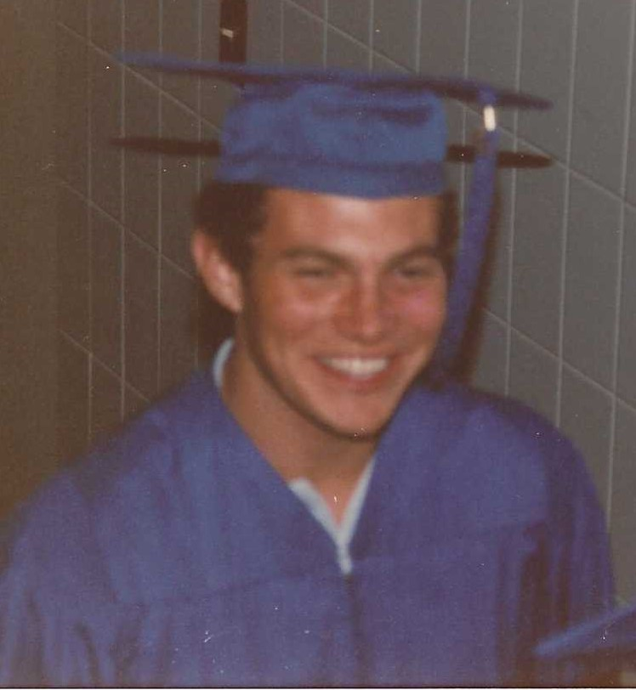
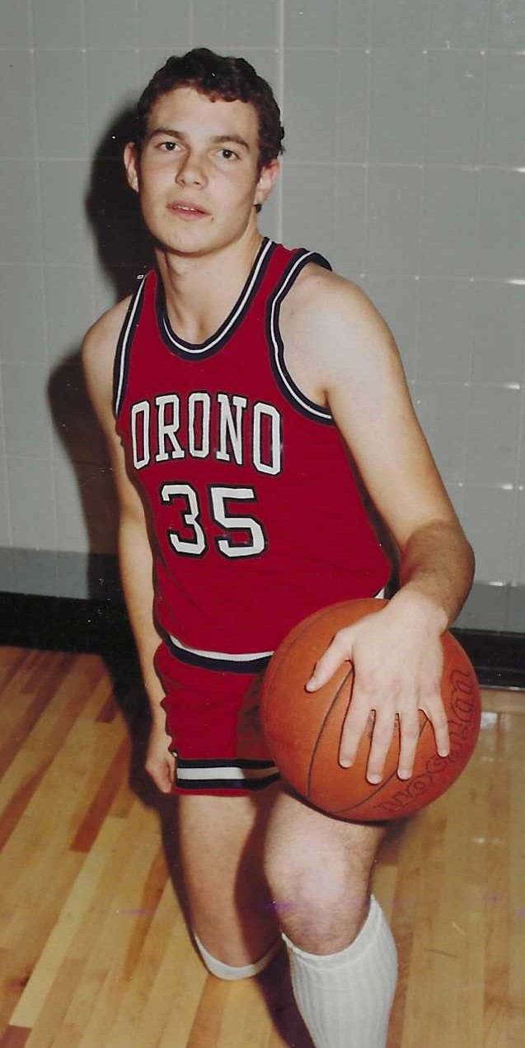
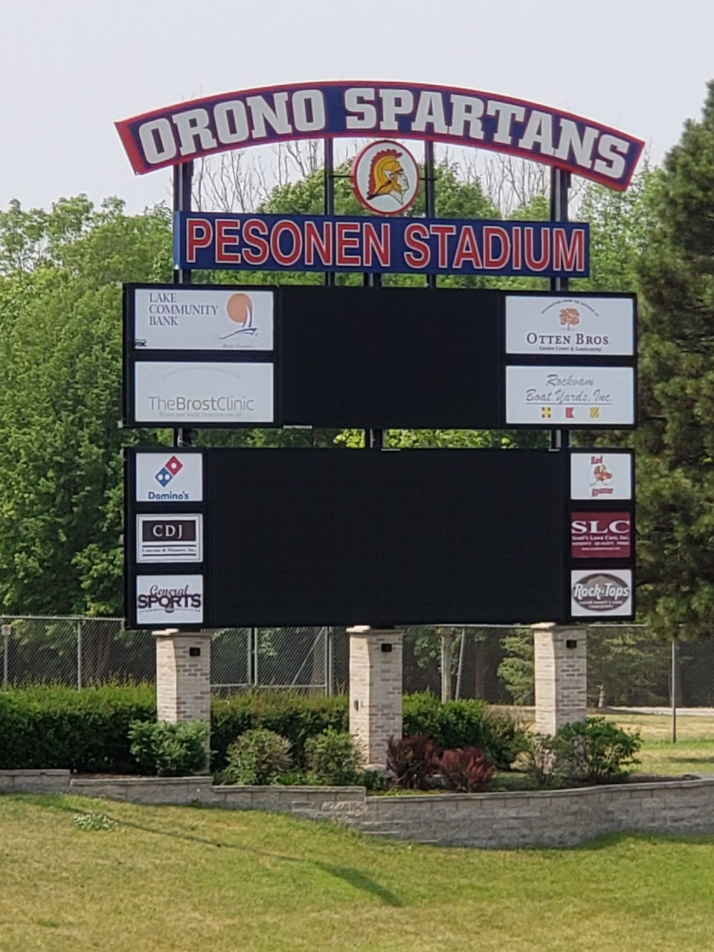
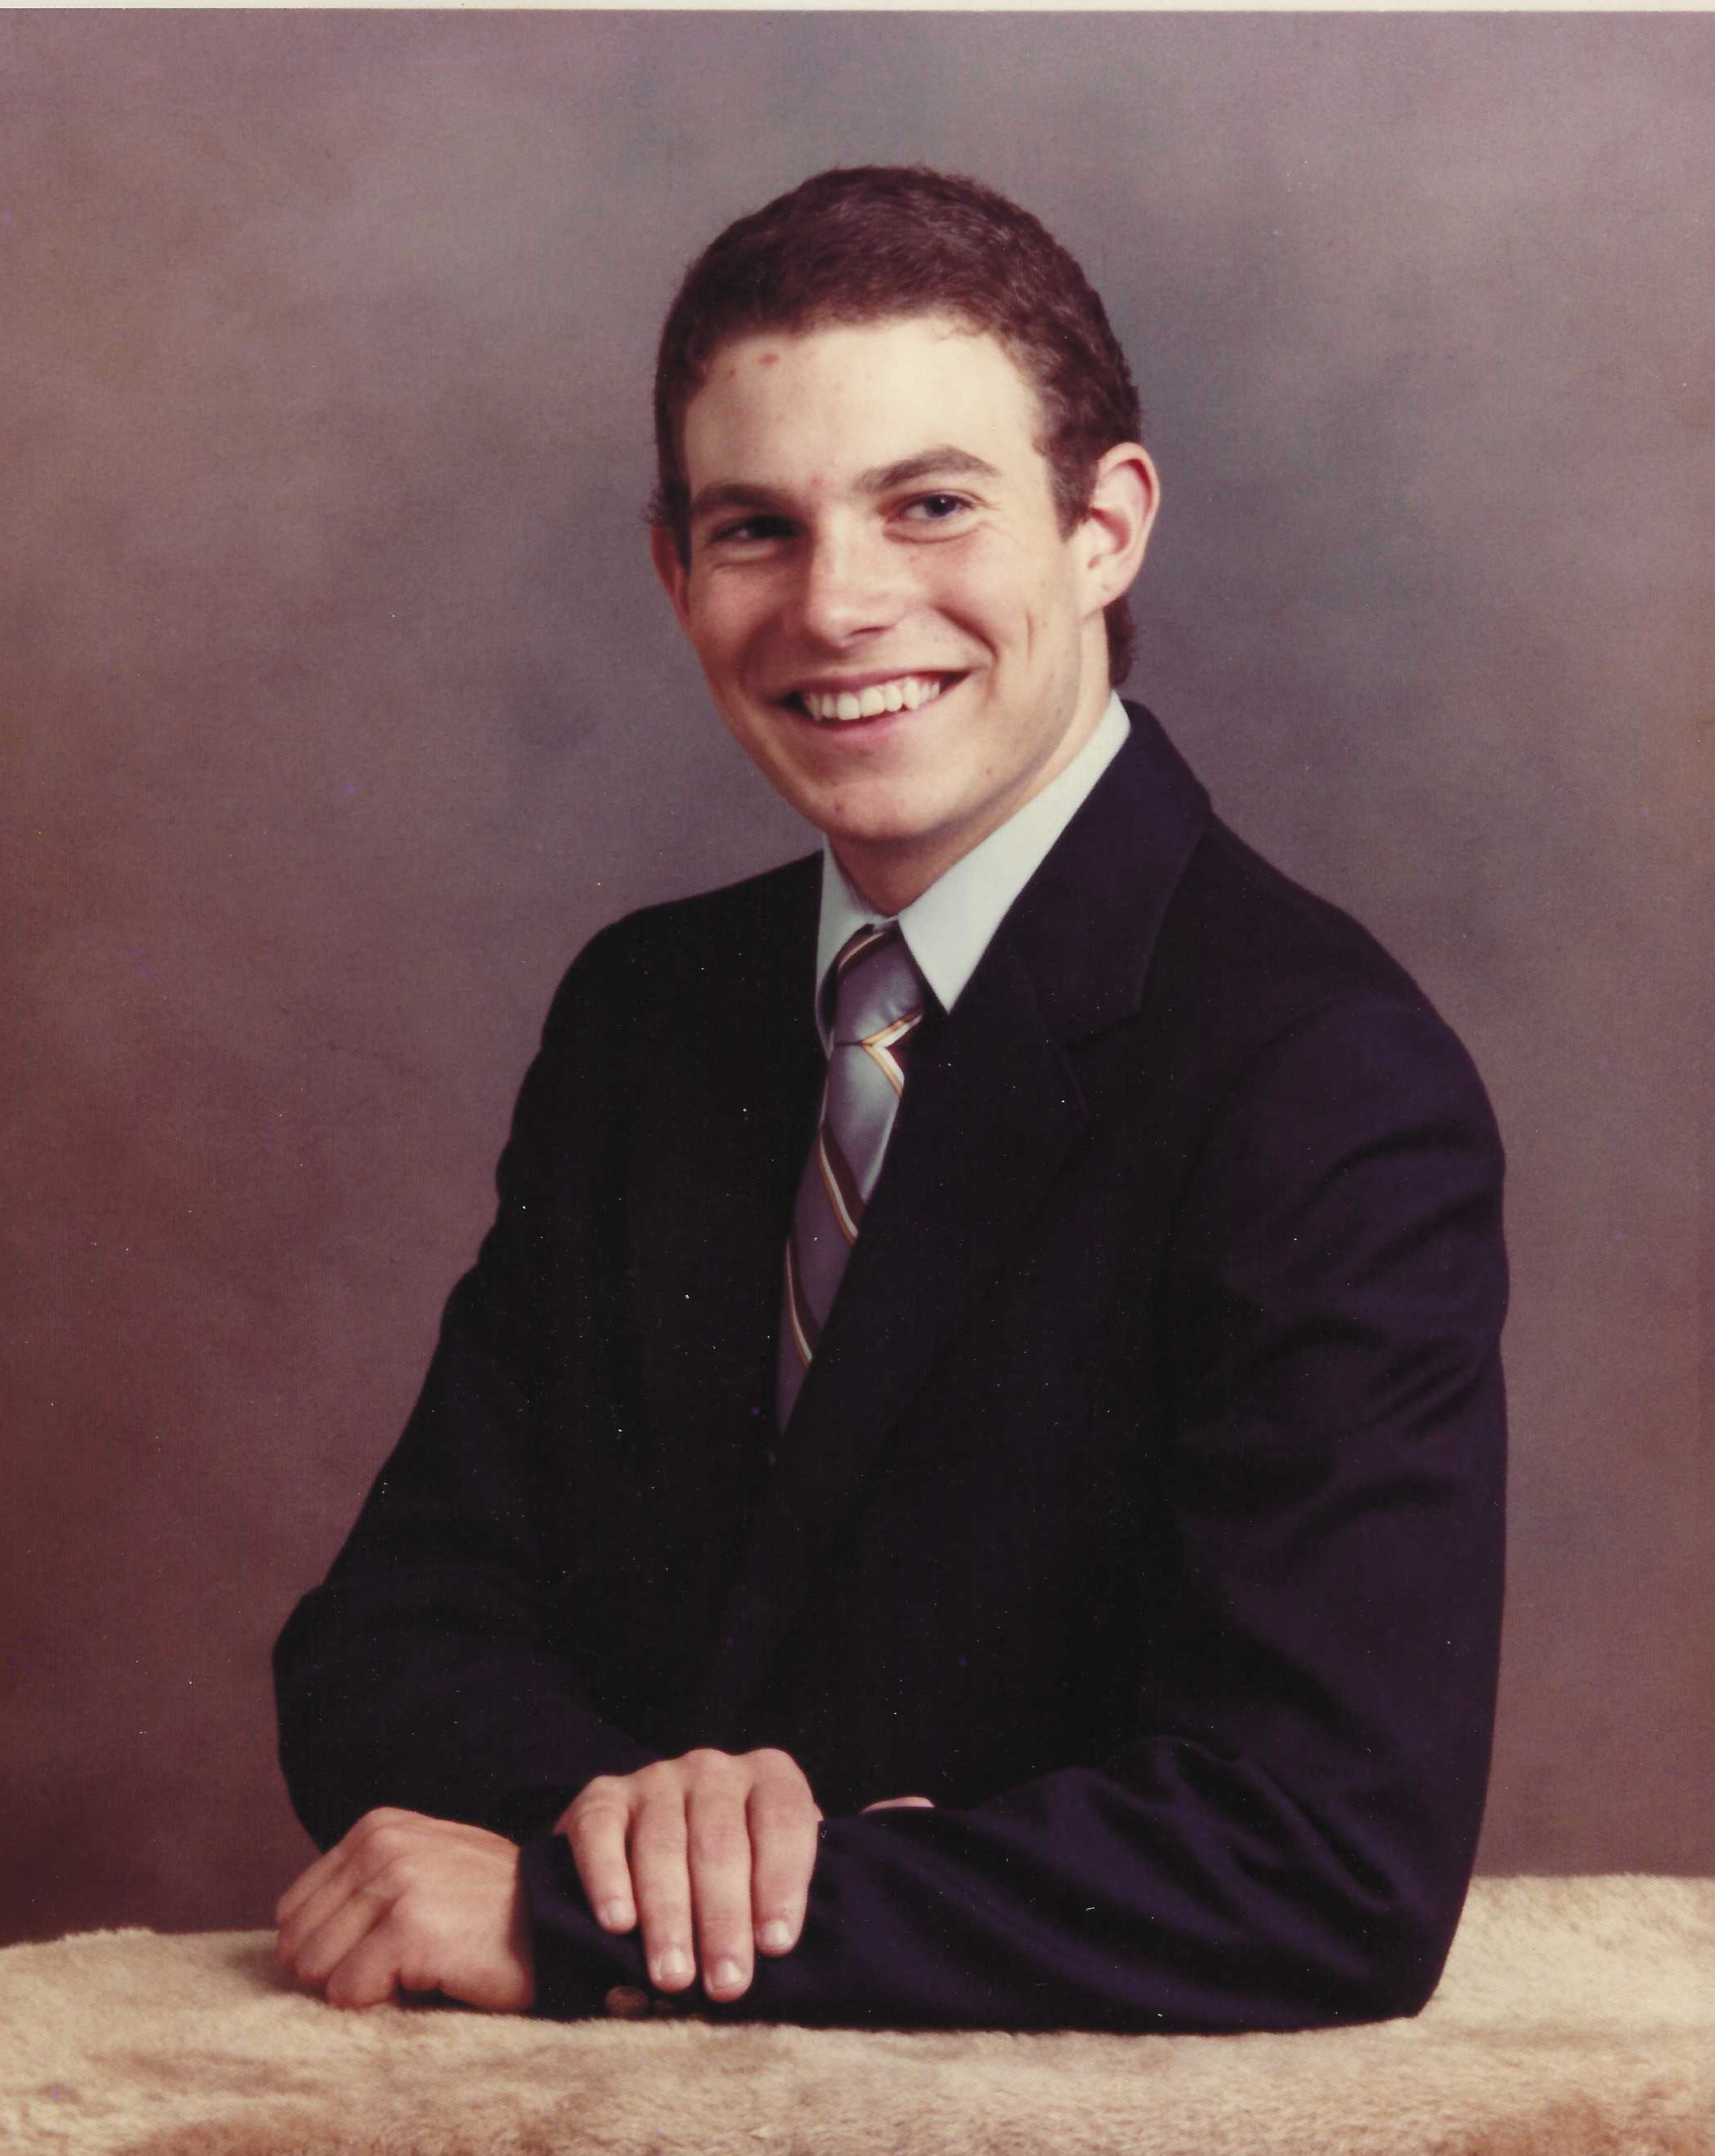
Orono High School

Slide 6
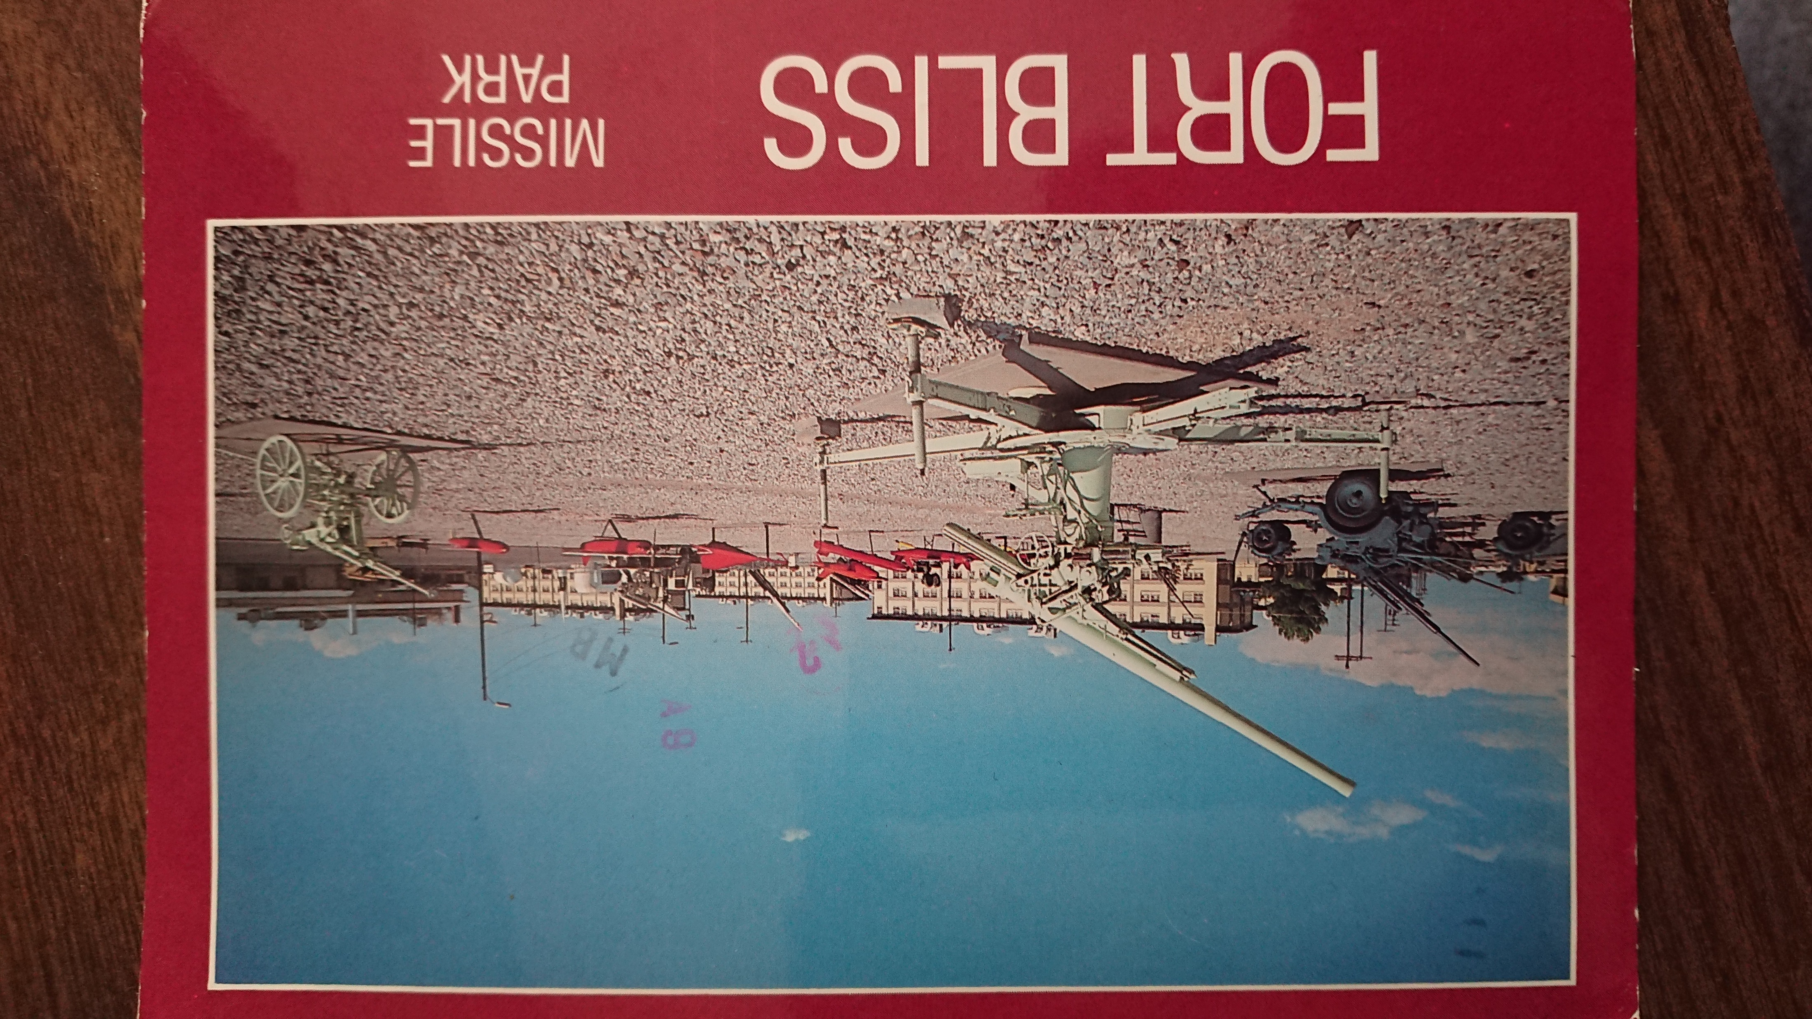
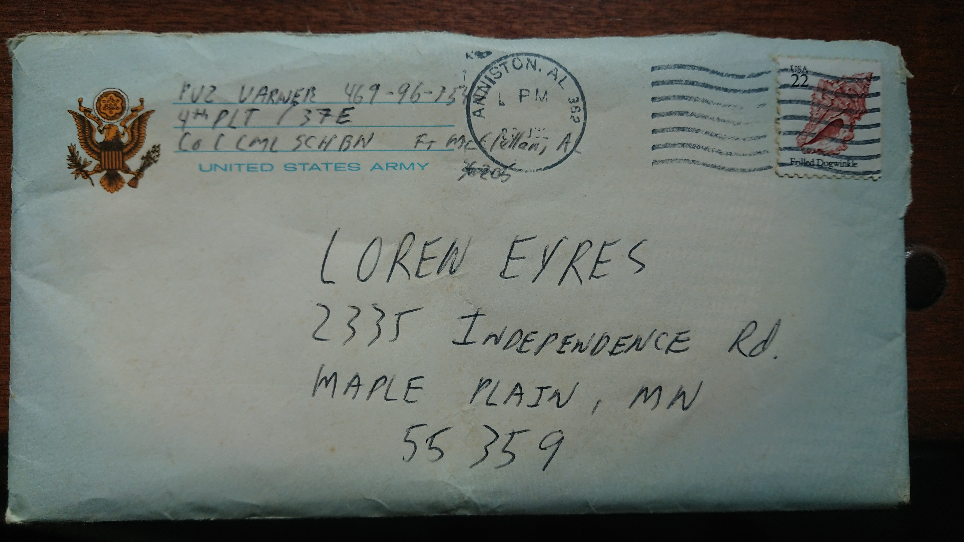
You’re in the Army now…
Gary from Basic Training: Fort Bliss, TX
June 1984
“…if you are going to write, put everything down in one massive letter. I do 20 push-ups for every letter I receive (don’t be cruel).
PS. It’s not too bad here, but the first day was horrible and it’s going to be a long 8 weeks.”
Gary from Advanced NBC Engineer Training
June 1985 --
“I’m at Chemical Warfare School, and this course is very bogus.“

Slide 7
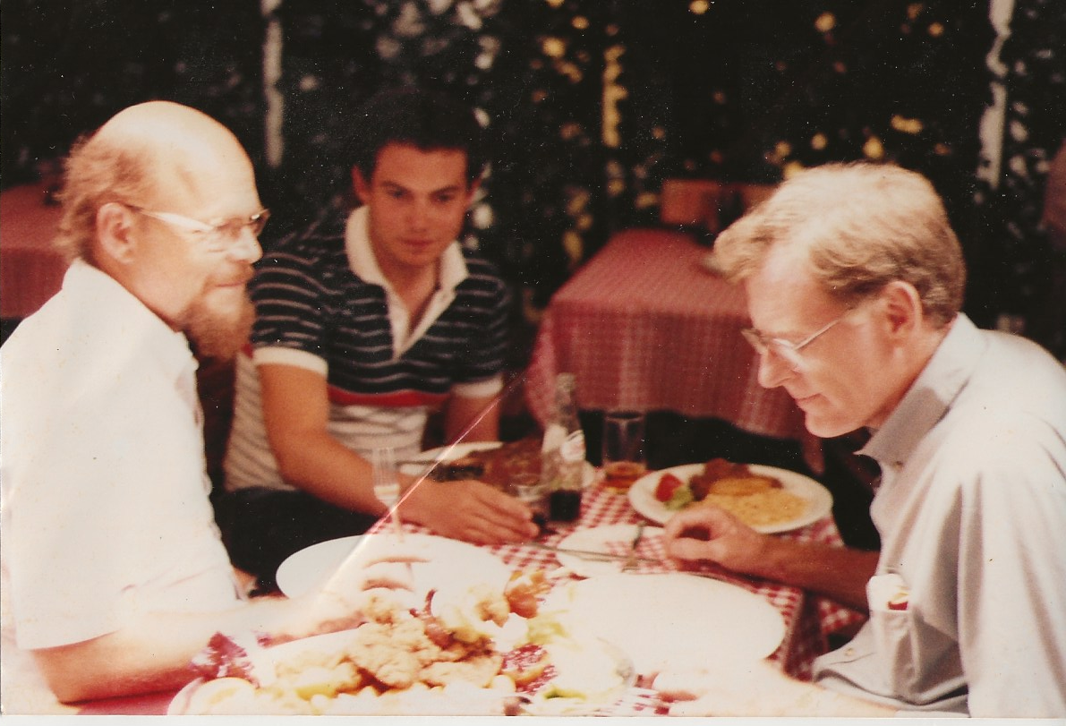
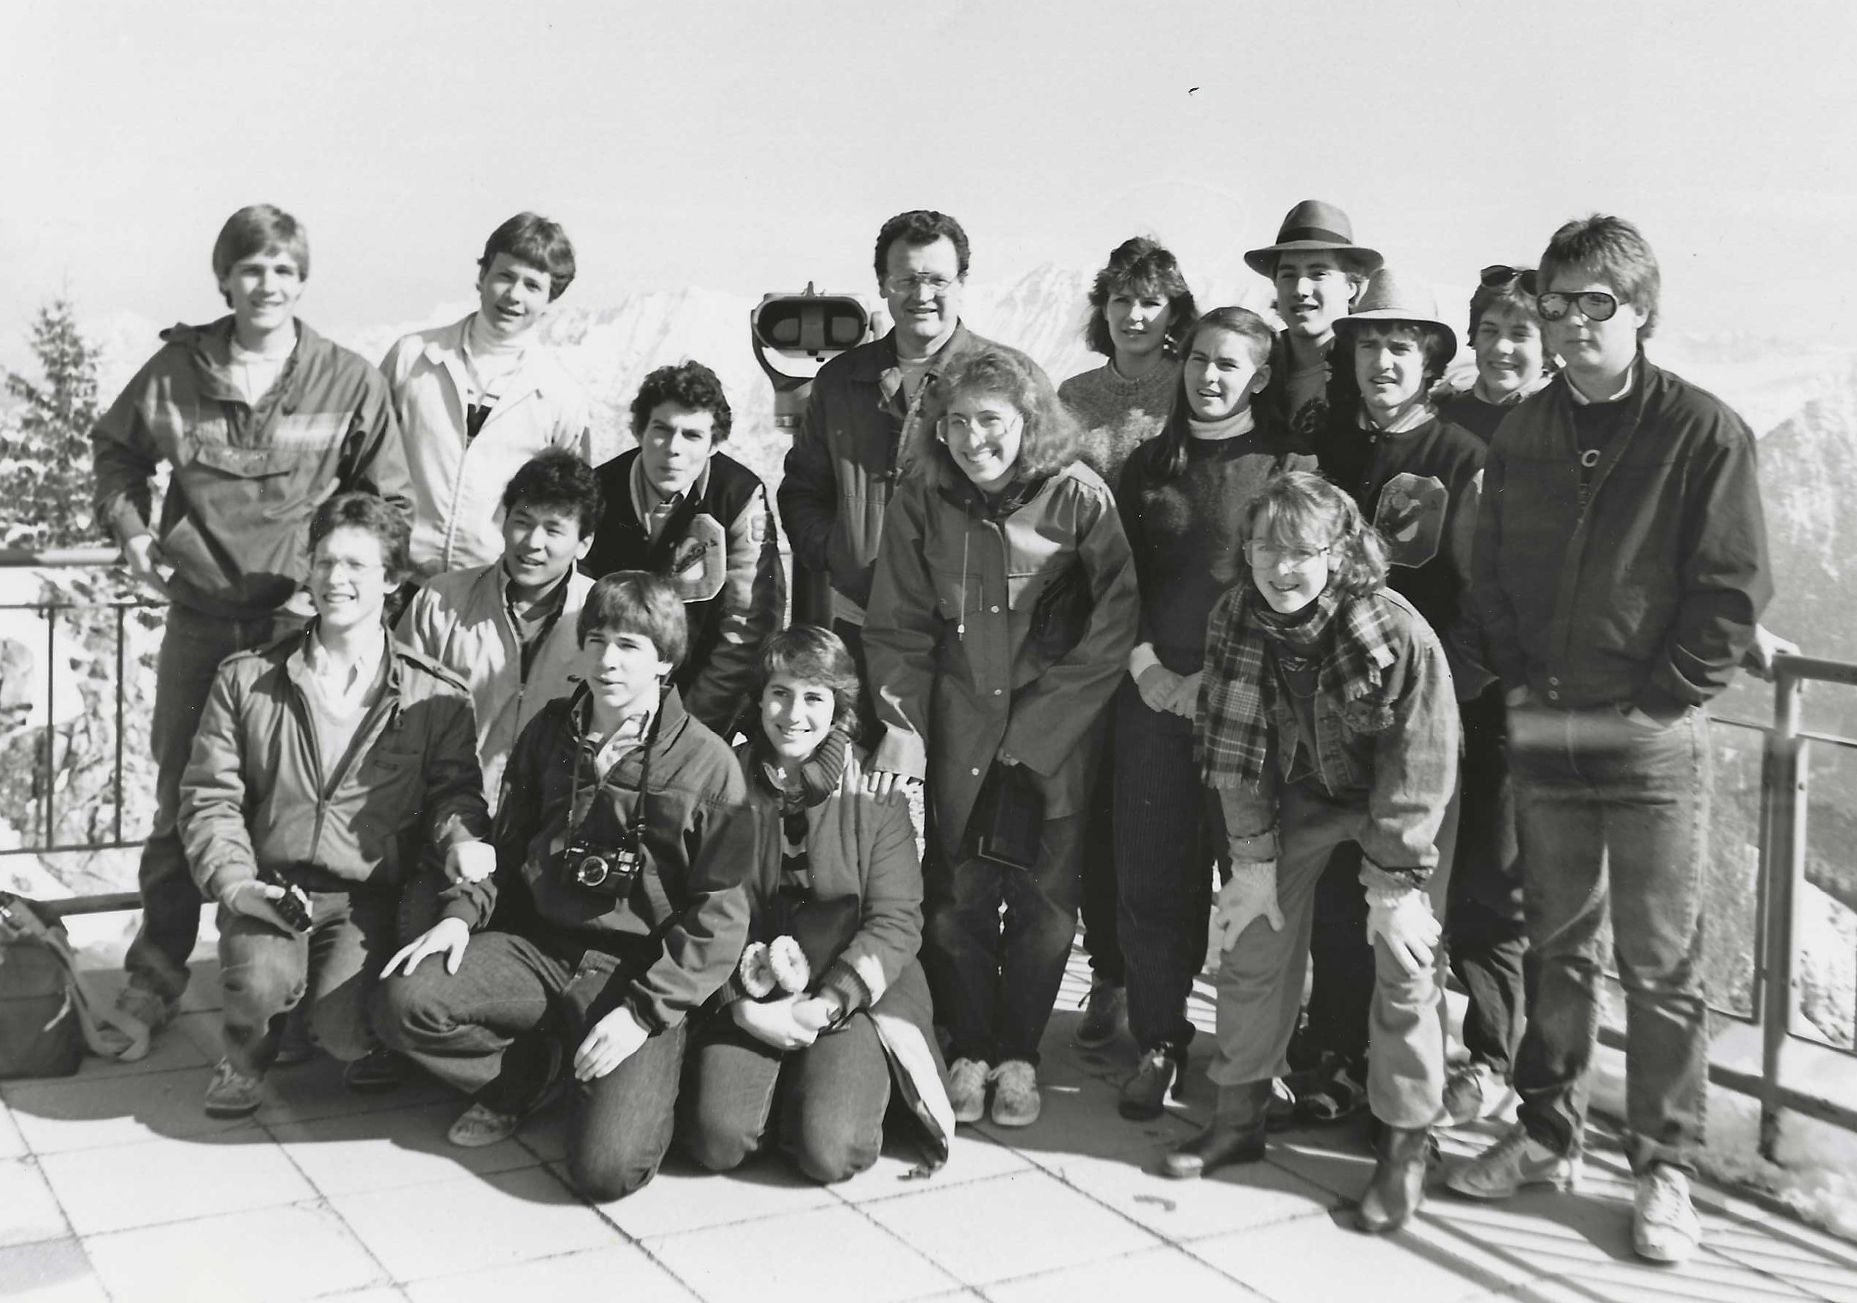
First steps abroad
Germany: High School German class trip – 1984
Germany, Austria: Trip with Sim, Mike, and Loren -- 1986

Slide 8
Gary’s self-reflection at 17:
“… it [some now-forgotten problem] kind of results from the fact that I only have 2 speeds: run and off.”

