Slide 1
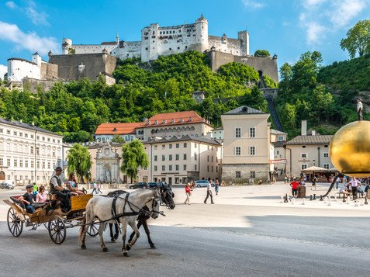
Relativity Part V
Doppler Effect
Momentum and Energy in Special Relativity
Quiz
E=mc²
Salzburg, Austria
What famous musician is from this town ?
Ans: Wolfgang Amadeus Mozart (1756-1791)
Read 37.9 General Relativity

Slide 2
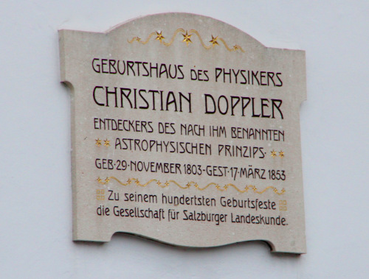
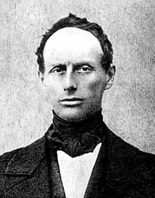
Can anyone here read German ?
Born in Salzburg, Austria
Discovered important astrophysical principle that bears his name

Slide 3
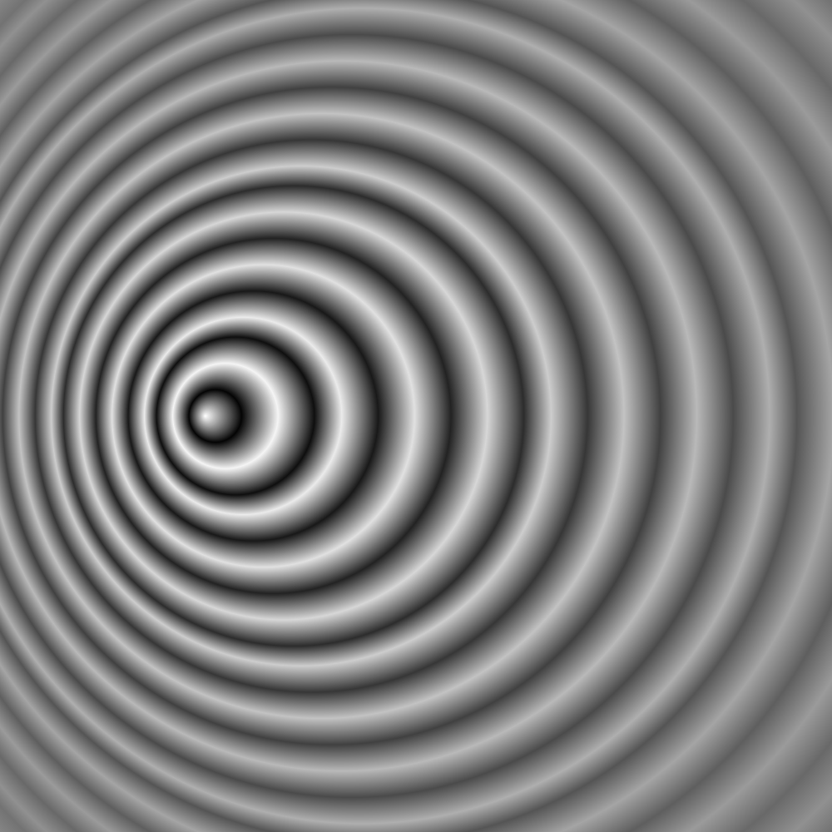
What is the Doppler effect for electromagnetic waves ?
“Blueshift”
“Redshift”
Source moving towards observer
Source moving away from observer
3
Notes:
Look at the wavefronts in this image.

Slide 4
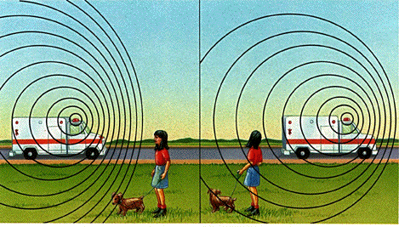
Doppler Effect in Daily Life

Slide 5
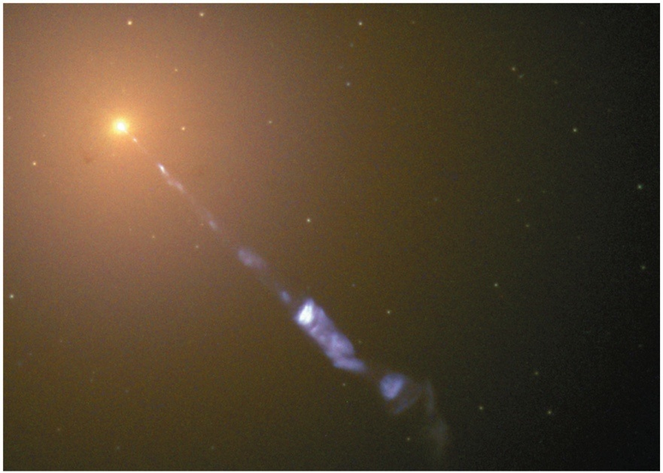
Doppler effect for electromagnetic waves
M87
Source approaching observer, “blue shift”, u is the speed of the source relative to the observer. The frequency of the source in its rest frame is f₀
Jet being ejected from a black hole. (f₀ =6.7 x 10¹⁴Hz→
f=5.6 x 10¹⁵Hz)
Red shift or blue shift ?
Source moving away from observer, “red shift”, u is the speed of the source relative to the observer. The frequency of the source in its rest frame is f₀
5
Notes:
Note that time dilation plays a role in the derivation in the text (somewhat different from the classical treatment)

Slide 6
Doppler effect (non-relativistic case)
Source approaching observer, “blue shift”, u is the speed of the source relative to the observer. The frequency of the source in its rest frame is f₀
What should I do next ? Why ?
6

Slide 7
Doppler effect for electromagnetic waves (non-rel)
Use the binomial expansion !
Uum what’s that ?
What happened to u²/c² ?
Warning !!: Only works for the non-relativistic case u<<c
7

Slide 8
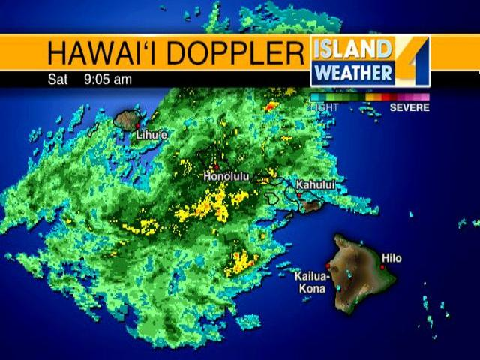
Applications of Doppler effect for EM waves
Many examples of Youtube videos for ambulance and police sirens (from now on please pay attention to the Doppler effect for sound !)
https://www.youtube.com/watch?v=YxlMvxEs2H8
8
Notes:
Doppler effect for radar is very important and useful.

Slide 9
Example of Doppler effect for EM waves (blue shift)
How fast must you be approaching a red traffic light (λ=675 nm) for it to appear green (λ=575 nm) ?
Not a good excuse for running a red light
9
Notes:
Not a good excuse. I get 0.1594c

Slide 10
Relativistic momentum
From our discussion of Lorentz transformations, velocities depend on the reference frame. Hence classical momentum will not be conserved in all inertial reference frames.
This is a serious problem. What can we do ?
Ans: define relativistic momentum (and later energy)
10

Slide 11
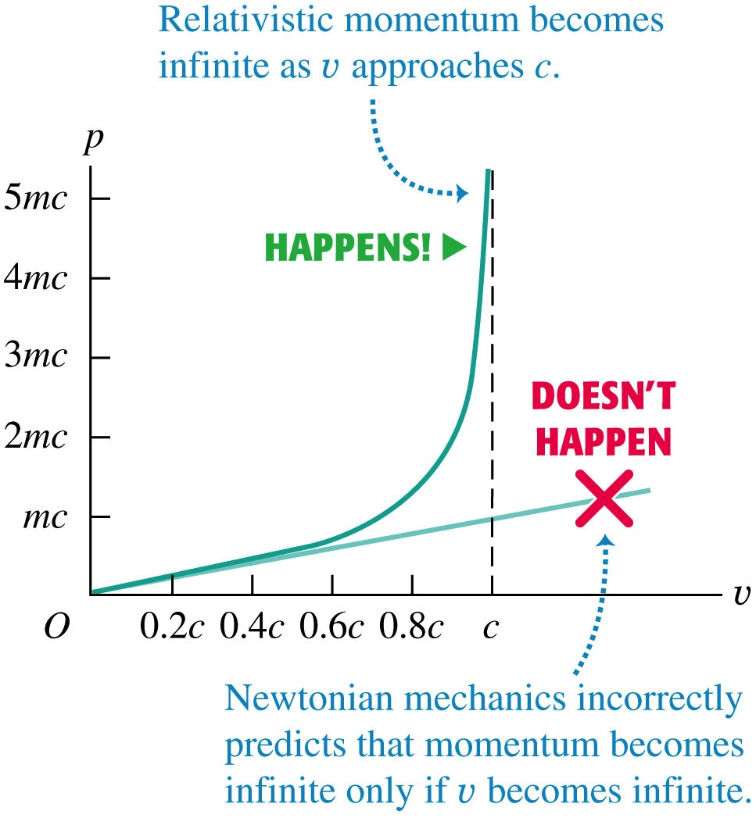
Relativistic momentum (cont’d)
Now introduce relativistic mass
11

Slide 12
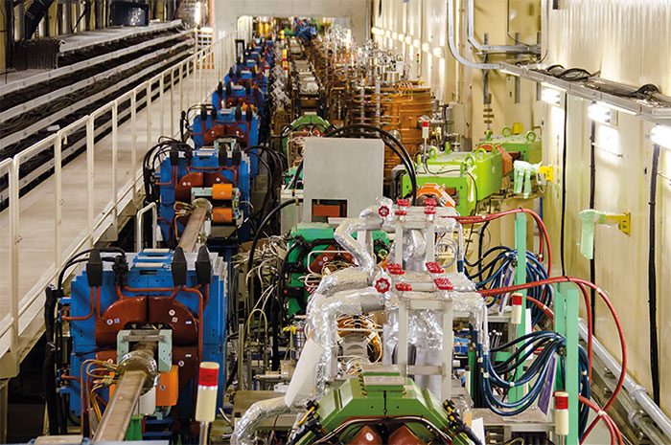
Relativistic momentum (cont’d)
What is γ for the
beam particles?
~300
~700
~2000
~7000
Particle accelerator: electrons and positrons moving at >99.999999% c
What can we conclude about the relativistic mass?
Beam energy is billions of electron-Volts, so most of the energy is in the relativistic mass (momentum)
12
Notes:
I get 7071

Slide 13
Q12.1
When a light source is stationary with respect to an observer. The observer detects the light frequency to be f_{o}.
When the light source moves toward the observer, the observer detects a frequency that is
greater than f_{o}.
less than f_{o}.
equals to f_{o}.
Notes:
A blue shift

Slide 14
Q12.1
When a light source is stationary with respect to an observer. The observer detects the light frequency to be f_{o}.
When the light source moves toward the observer, the observer detects a frequency that is
greater than f_{o}.
less than f_{o}.
equals to f_{o}.
A blue shift
Notes:
A blue shift

Slide 15
Q12.2
According to the relativistic expression for momentum, if the speed of an object is doubled, the magnitude of its momentum
A. increases by a factor greater than 2.
B. increases by a factor of 2.
C. increases by a factor greater than 1 but less than 2.
D. depends on the value of the initial speed.
Notes:
Answer: A ; p= gamma m v

Slide 16
Q12.2
According to the relativistic expression for momentum, if the speed of an object is doubled, the magnitude of its momentum
A. increases by a factor greater than 2.
B. increases by a factor of 2.
C. increases by a factor greater than 1 but less than 2.
D. depends on the value of the initial speed.
p = γ mv
Notes:
Answer: A ; p= gamma m v

Slide 17
Q12.3
Compare the formula for the Doppler effect for electromagnetic waves when the source moves toward the observer vs. when the observer moves to the source.
The two formulae are the same.
The first case gives a higher frequency than the second case.
The first case gives a lower frequency than the second case.
Notes:
A

Slide 18
Q12.3
Compare the formula for the Doppler effect for electromagnetic waves when the source moves toward the observer vs. when the observer moves to the source.
The two formulae are the same.
The first case gives a higher frequency than the second case.
The first case gives a lower frequency than the second case.
Notes:
A

Slide 19
Relativistic Force (on our way to E=mc²)
If v is along the x-axis and acceleration is constant, then can obtain a simple form for F.
Use d/dx(x^{n})=nx^{n-1}
Need to use the product rule for differentiation
19

Slide 20
Relativistic Force (on our way to E=mc²)
If v is along the x-axis and acceleration is constant, then can obtain a simple form for F.
Use d/dx(x^{n})=nx^{n-1}

Slide 21
Relativistic Work (on our way to E=mc²)
How do we do this integral ?
Change variables, let
s=1-v²/c², ds=-2v/c² dv.
Int (x^{n}) dx=x^{n+1}/(n+1).
Go from rest to v.

Slide 22
Relativistic Work (on our way to “E=mc^{2”})
K= Kinetic Energy.
Here E= γmc² and mc² is the “rest mass energy”
Is there an equivalent of rest mass energy in classical Newtonian physics ?

Slide 23
Relativistic Kinetic Energy (non-relativistic limit)
K= Kinetic Energy.
Do you remember the binomial expansion ?
What is the expansion parameter ?
How can we expand this in the limit v/c<<1 ?
So we obtain

Slide 24
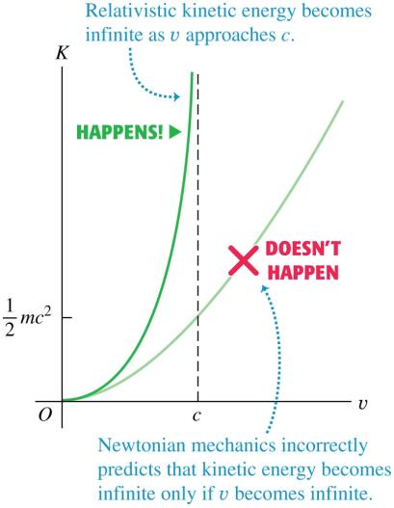
Relativistic work and energy
The relativistic kinetic energy is K = (γ – 1)mc². The graph in Figure 37.21 (right) shows the kinetic energy as a function of speed. Note that the kinetic energy approaches infinity as the speed approaches the speed of light.
The rest energy is mc².
The total energy of a particle is E = K + mc² = γmc².
The total energy, rest energy, and momentum are related by E² = (mc²)² + (pc)².

