Slide 1
Some Lessons Learned from Deep Oceanographic Neutrino Telescopes
Pacific Ocean Neutrino Explorer (P-ONE)
General Meeting 22 July 2019
University of Alberta
John G. Learned
University of Hawaii
This draws upon my 2019 Neutrino Telescopes talk about the history and future of neutrino astronomy. There I quoted many slides from Amy Connelly at ARENA2018… excellent summary talk. Christian Spiering helped greatly with the tables of past, current and future projects. The comments and lessons are from my own experience with attempts at neutrino astronomy from the 1970’s onwards and particularly as head of DUMAND through the 80’s and into the 90’s.

Slide 2
Beginnings of HE Nu Astronomy
The journey to high energy neutrino astronomy starts with fantastic dreams in Russia and US in 1950’s with pioneers such as Moisei Markov, George Zatsepin, in Russia and Ken Greisen, and Fred Reines in the USA, and who first articulated the dream of detecting cosmic neutrinos, hopefully permitting us to view the universe in a very different light than photons. (Ref. Markov1960)
1969 Berezinsky and Zatsepin propose the generation of neutrinos due to the GZK cutoff in cosmic protons ~10²⁰ eV.(Still not seen!)
DUMAND Begins at talks in 1973, International Cosmic Ray Conference (ICRC) F. Reines, J. Learned, H. Davis, P. Kotzer, M. Shapiro (all USA), G. Zatsepin (USSR) and S. Miyake (Japan)
discuss a deep-water detector.

Slide 3
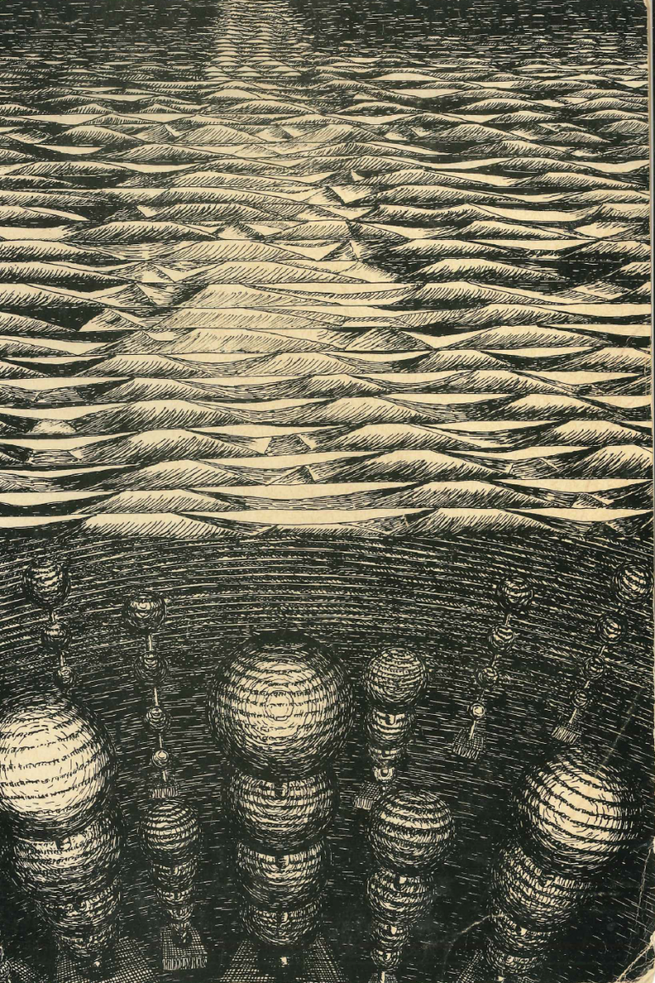
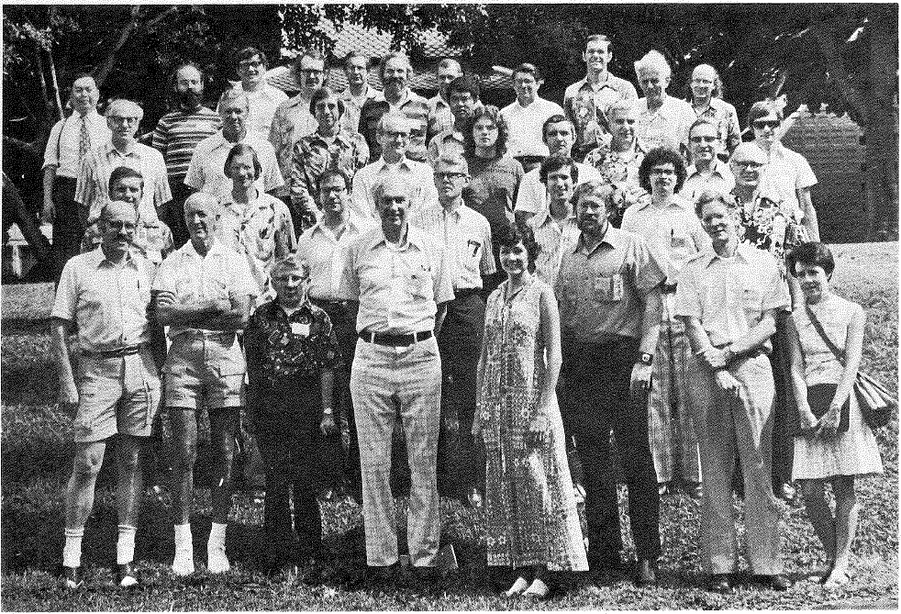
The Real Birth of the present quest 1976 DUMAND Summer Workshop
Basically we had no idea what we were doing…
Had ideas about starting neutrino astronomy from deep below the earth surface, with water or sold targets.
No prior guidance as to best chances with
- High energy (>> GeV) neutrinos or
- Low energy (1-100 MeV) neutrinos
Almost no prior estimates of flux at high energies… astrophysicist did not think neutrinos
No prior guidance about best detection mechanisms
Optical, Radio, Acoustic discussed seriously

Slide 4
We knew what it would take 40 years Ago!
1978: DUMAND
First design of a cubic kilometer
detector to be in deep ocean Hawaii
- While exploring other techniques
we knew that optical detectors would
do the job
Large PMTs in glass housings practical
New techniques (radio, acoustic) were
known to be for > TeV energies
No reasonable predicted fluxes at > PeV
Lower energy regime aimed at Atm Nus,
solar and SN
- Made first designs for large underground
detectors for the lower energy regime,
in particular IMB, Kamiokande, and HPW
1 km

Slide 5
1980’s Saw First Large Nu Detectors
Race to find proton decay, PDK… still none!
IMB & Kam found “Muon Neutrino Anomaly”, controversial through decade
Kamiokande observed solar neutrinos!
Kam, IMB and Baksan observed SN1987A
Despite scans of sky maps of atmospheric neutrino directions, no hint of cosmic nus

Slide 6
NuTel 1990

Slide 7
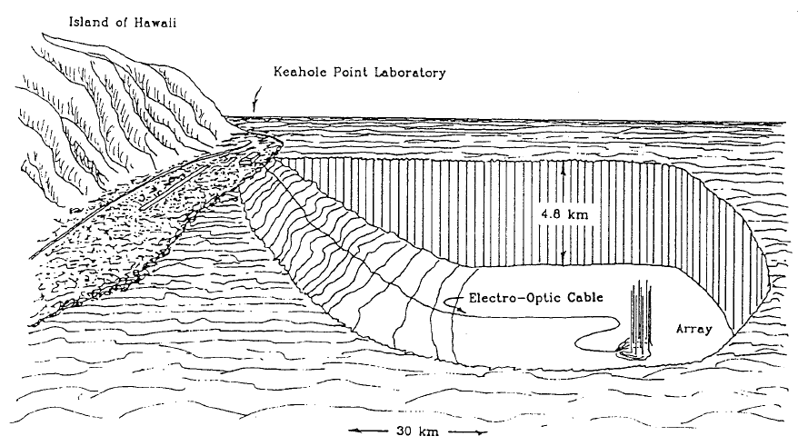
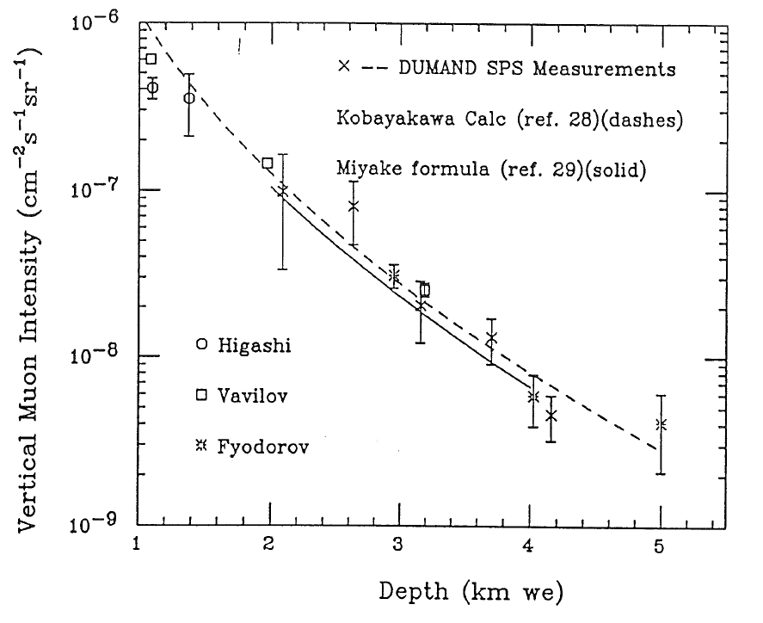
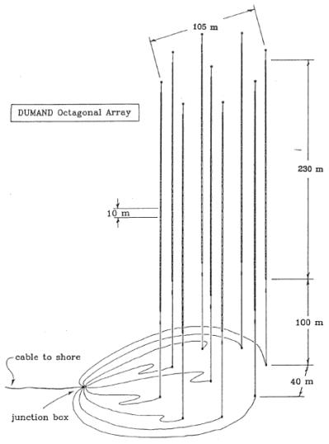
DUMAND Nostalgia
Circa 1990
Intended for 1993
Done
1989
Only cable
J-box and
Monitoring
Deployed

Slide 8
1990 Summary of large detectors
3 of 19 still operating
-> 2019
X
O
X
X
X
X
X
X
X
X
O>X
X
O
O>X
-> BOREXINO

Slide 9
1990 Summary of then New Initiatives
1 operating!
X
O>X
X
X
X
X
X
X
X
X
X
X

Slide 10
2019 Recent, Operating and Imminent Large Natural Neutrino Projects; 16, 6 Operating
project | loc | st | Area / Vol | dΩ | energy | tech | goal
BaikalNT200 | Siberia | X | 2000 m² | 2π | 10 GeV | WC | ν astr
SAGE | Baksan | O | 50 T | 4π | 0.1 MeV | Gal. | Solar
AMANDA | So. Pole | X | 3x10⁴ m² | 4π | 50 GeV | IC | ν astr
Auger | Argent. | O | 3x10⁴km² | 2π | EeV | AC | EAS
IceCube | So.Pole | O | 1 km² | 4π | 100 GeV | IC | ν astr
Borexino | Gr. Sasso | O>X | 100 T | 4π | 1 MeV | LS | Solar
NESTOR | Greece | X | 10⁴ m² | 2π | GeV | WC | ν astr
NEMO | Sicily | X | 10⁴ m² | 2π | GeV | WC | ν astr
Antares | France | O | 3x10⁴ m² | 2π | 20 GeV | WC | ν astr
SuperK | Japan | O | 22 kT | 4π | 4 MeV | WC | PDK
SNO | Canada | X | 1 kT | 4π | 2 MeV | HWC | sν astr
KamLAND | Japan | O | 600 T | 4π | 1.8 MeV | LS | rν osc
Anita | Antarctic | X | 10⁶ km² | 10⁻⁶ | 5 EeV | ICR | ν astr
ARA | So. Pole | C | 100 km² | 2π | ~ EeV | IR | ν astr
Arianna | Antarctic | C | 10 km² | 2π | >EeV | IR | ν astr
SNO+ | Canada | T | 800 T | 4π | 2 MeV | LS | DBD

Slide 11
2019 Future Projects, 16
project | loc | st | area/vol | En. thr. | tech | goal
ASHRA | Hawaii | P? | 20 km² | EeV? | AC | ν astr
Pueo | So. Pole | P | 10⁶ km² | 3 EeV | IR | ν astr
IceCube-Gen2 | So. Pole | P | 9 km² | 10 TeV | IC | ν astr
ARA+ | So. Pole | P | 120 km² | 50 PeV | IR | ν astr
Baikal-GVD | Siberia | C | 0.4>2 km² | 100 GeV | WC | ν astr
Baksan Scint. Det. | Caucasus | P | 10 kT | 100 MeV | LS | ν astr
HyperKam. | Japan | T/C | 260 kT | 6 MeV | WC | ν osc/pdk
Jinping | China | P | 3000 T | 1 MeV | LS | geo ν
DUNE | Homestake | C | 34 kT | 100 MeV | LAr | ν osc
Theia | Homestake | P | 50 kT | 2 MeV | LS | ν astr
GRAND | China | P | 2x10⁵km² | 100 PeV | RC | ν astr
Pingu | So. Pole | P | 6 MT | 8 GeV | IC | ν osc
KM3NET/ORCA | Mediter. | C | 8 MT | 10 GeV | WC | ν osc
KM3NET/ARCA | Mediter. | C | 1.2 GT | 10 GeV | WC | ν astr
JUNO | China | C | 20 kT | 1 MeV | LS | Rν osc
INO | India | T | 50 kT | 600 MeV | Fe | Atm ν
P-ONE | Pacific-Canada | C | 1 km2 ? | GeV ?? | WC | ν astr
Future Projects 17

Slide 12
Key for previous tables comparing projects:
st = status
P = proposal
C = construction
T = testing
O = R = operating
X = no longer operating
R>X = O>X soon shutting down
Area/vol = muon effective area or target volume/mass, very rough measure
and generally energy dependent
dΩ = observing solid angle
Energy = rough neutrino energy threshold
Tech = detection technology
AC = Air Cherenkov
IC = Ice Cherenkov
WC = Water Cherenkov
HWC = Heavy Water Cherenkov
IR = Ice Radio
ICR = Ice Cherenkov Radio
LS = liquid scintillator
AR = Air Radio
Fe = Iron Calorimeter
ν astr = Neutrino Astronomy
ν osc = Neutrino Oscillation Studies
Rν osc = Reactor Neutrino Oscillation Studies
PDK = Proton Decay Search
geoν = mainly geo-neutrino studies
Please let me know about
errors and omissions!
With much help from
Christian Spiering

Slide 13
OK, where are we and where are we going soon with neutrinos?
At lower energies (<TeV) we have found neutrino oscillations and mass
and much more about neutrinos… amazing experimental results
~ lifetime, they make it from distant objects at ~c
~ standard model cross sections, but >EeV quite uncertain
~ 3 families and weak hints of more (revolution if so)
~ mixing angles curiously larger than for quarks, forget Cabibbo
~ mass trending towards m1 < m2 < m3 as with quarks, but why?
~ unclear about CP violation (but really so what, RH nus?)
~ some peculiarities in nuclear reactor nu expts (RNA and 5 MeV bump)
~ solar models and atm nu fluxes ~ OK (to 15% or so!)
~ no observation of expected Direct Production (OK?)
And still no theory guidance from a grand scale GUT
Still we know very little more about cosmic rays and sources > PeV

Slide 14
Review of opportunities for natural neutrinos by energy:
- Big Bang Relics: No good ideas out there… biggest challenge,
only indirect inferences
- Pre-white dwarves: Dominant radiation in neutrinos
but keV energies, no flux calcs
- <MeV Geo neutrinos: particularly K40, important challenge
- Relic SN Neutrinos: in few MeV range, maybe in reach of HyperK
- Galactic SN: 10’s of MeV… few/century, could be any time
- Atmospheric Neutrinos: 100 MeV to >TeV, continue to be a
gold mine for nu properties
- Few TeV from mostly galactic sources: IceCube now, others follow
- <100 TeV astro nus: could yield wonderful surprises, IC in progress
- 1-10PeV: as now seen in IC: the promised land and
probably most fruitful in ~10 yrs
- Glashow ~6.4 PeV and Double Bang: astro nu flavors coming, slowly
- EeV: Where are the BZ neutrinos?
- And what are those ANITA events? This is indeed terra incognita

Slide 15
Focusing on UHE Astro Neutrinos
Below PeV optical detectors will continue to dominate, but
current IceCube and others not big enough to move ahead
In the range of PeV -> EeV we clearly need help from
New Detectors and
New Techniques
Above PeV, due to E² scaling Radio and
maybe Acoustic will come to the fore

Slide 16
conclusion
After half a century of dreaming, exploration and development, and now great activity
we are seeing the Promised Land, we have a glimpse of HE Neutrino Astronomy
It is sparse but we know how far we must go…
Need ~100 km3 for the high energies!
The mysteries of neutrino behavior and the sources of the most energetic events in the universe remain enigmatic, but within grasp
You can bet on suprises!

Slide 17
Some Advice for Ocean Neutrino Hunters some controversial from jgl experiences (random order)
First off plan to test, test, test and in-ocean!
Connectors are the bane of our experiments… source of most failures.
Experienced Physicists should be overall involved in the design details, not handing over to engineers.
Avoid review committees without ocean experience!
Unlike IceCube, design for service and reconfiguration.
Buy all possible components, from proven mfrs.
Reprogrammable software in ocean.
More than one data link to shore, no single point fail.
In the past, large stupid light collectors always won. Now?
Beware stored charge in HV ocean cables… Total power an issue.
Neutrino induced showers, not muons, are your future.
Work on shower directionality reconstruction to go beyond IC.
Plan for eventual ~10 KM³

Slide 18
Special Opportunity : Incorporate MeV Neutrino Detector
OceanBottomKamLAND stirring in Japan
10-50 KT closed detector of Geonus, and more
Can be deployed with help of huge Japanese Chikyu drill ship, connected to Neptune?
P-ONE forms giant trigger/veto
Much like IceCube with dense core, but better!
Much synergy between OBK and P-ONE.
I hope we can start useful discussions with you all and colleagues at Tohoku U (Kamland)/

Slide 19
P-ONE
This looks to be a grand adventure and I send best wishes for rapid advancement.
I hope we can work out means for some possible UH participation,
and for linking to the budding OBK in Japan
Have an exciting meeting!

